Slide 1


Navigating Licensure Related Topics
Notes:
Welcome to this video, which is a Practice Tool highlighting topics related to state licensure.

Slide 2
Table of contents
Delivering Nutrition-Related Services Via Telehealth
1
CDR Credential vs State Licensure: What is the Difference?
2
Case Study
3
© 2026 Academy of Nutrition and Dietetics
Notes:
Practice tips can help credentialed practitioners navigate their practice by providing valuable resources and asking critical through-provoking questions. This video will cover two practice tips and a case study.

Slide 3

Licensure Overview
Goal of Licensure
To ensure that licensees have achieved the minimum degree of competency necessary to ensure that the public’s health, safety, and welfare are reasonably well protected.
State License Categories
State licensing generally falls under one of two categories:
Title protection
Practice Exclusivity
Cross Border Regulations
If providing services in multiple states (in-person or via telehealth), RDs must be licensed in each state, unless exempt.
© 2026 Academy of Nutrition and Dietetics
Notes:
The general goal of state licensure is to ensure that licensees have achieved the minimum degree of competency necessary to ensure that the public’s health, safety, and welfare are reasonably well protected.
State licensure generally falls under one of two categories, title protection and practice exclusivity.
In general, states with title protection require that only licensed practitioners may use particular titles, which differ state to state, but there are no requirements pertaining to who can and cannot provide nutrition-related services.
Alternatively, states with practice exclusivity require that only licensed practitioners provide services that are within the profession’s scope of practice, unless otherwise exempt. Again, these services may vary from state to state and will be outlined in the states licensure laws and/or statutes.
Finally, if you are providing services in multiple states, you must be licensed in all states where your clients reside unless you are exempt or the state doesn’t offer licensure for RDs.

Slide 4

Delivering Nutrition-Related Services Via Telehealth
© 2026 Academy of Nutrition and Dietetics

Slide 5
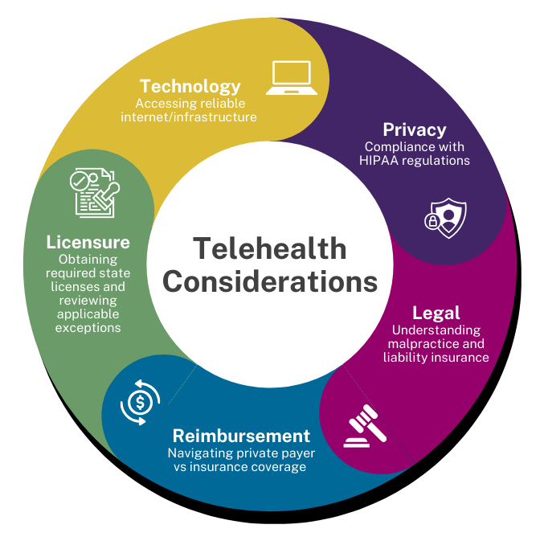
Telehealth Considerations
© 2026 Academy of Nutrition and Dietetics
Notes:
There are several factors that you’ll need to consider before providing nutrition services via telehealth.
1) The Requirements for technical infrastructure depend on the services being provided, however, most telehealth programs require high rates of data transmission, so access to reliable broadband internet is necessary. Typically, a public internet connection is not sufficient for this purpose, even when encryption is available to prevent the communications from being intercepted.

Slide 6
Telehealth Considerations
© 2026 Academy of Nutrition and Dietetics
Notes:
2) It is imperative that practitioners understand and comply with the Health Insurance Privacy and Accountability Act (HIPAA) regulations.

Slide 7
Telehealth Considerations
© 2026 Academy of Nutrition and Dietetics
Notes:
Prior to starting or transitioning to a telehealth practice, review your malpractice and liability insurance policies to ensure telehealth services are a covered activity, as some policies specifically exclude it and others don’t mention it at all. If telehealth is not specified as a covered activity, supplemental insurance may be needed.

Slide 8
Telehealth Considerations
© 2026 Academy of Nutrition and Dietetics
Notes:
Private insurance coverage and reimbursement for MNT-related services in general, varies significantly by insurance company and by specific products/plans. Since there is no federal legislation requiring private payer reimbursement for telehealth services, states determine if and how telehealth practice and reimbursement is regulated, and each insurer sets its own policies related to coverage, coding, and payment for these services.

Slide 9
Telehealth Considerations
© 2026 Academy of Nutrition and Dietetics
Notes:
In general, you should be able to provide telehealth services to patients/clients who reside in the state(s) where you hold licensure/certification, given your license is in good standing and you’re complying with all applicable standards.
Some states offer reciprocity or other types of exemptions that may allow you to provide services under certain circumstances without a licensure/certification. Because each state’s requirements are different, credentialed practitioners are responsible for reviewing all applicable laws and regulations before providing services. RDNs in states without licensure laws must be credentialed and privileged, via the traditional route, by each hospital in which they practice.

Slide 10
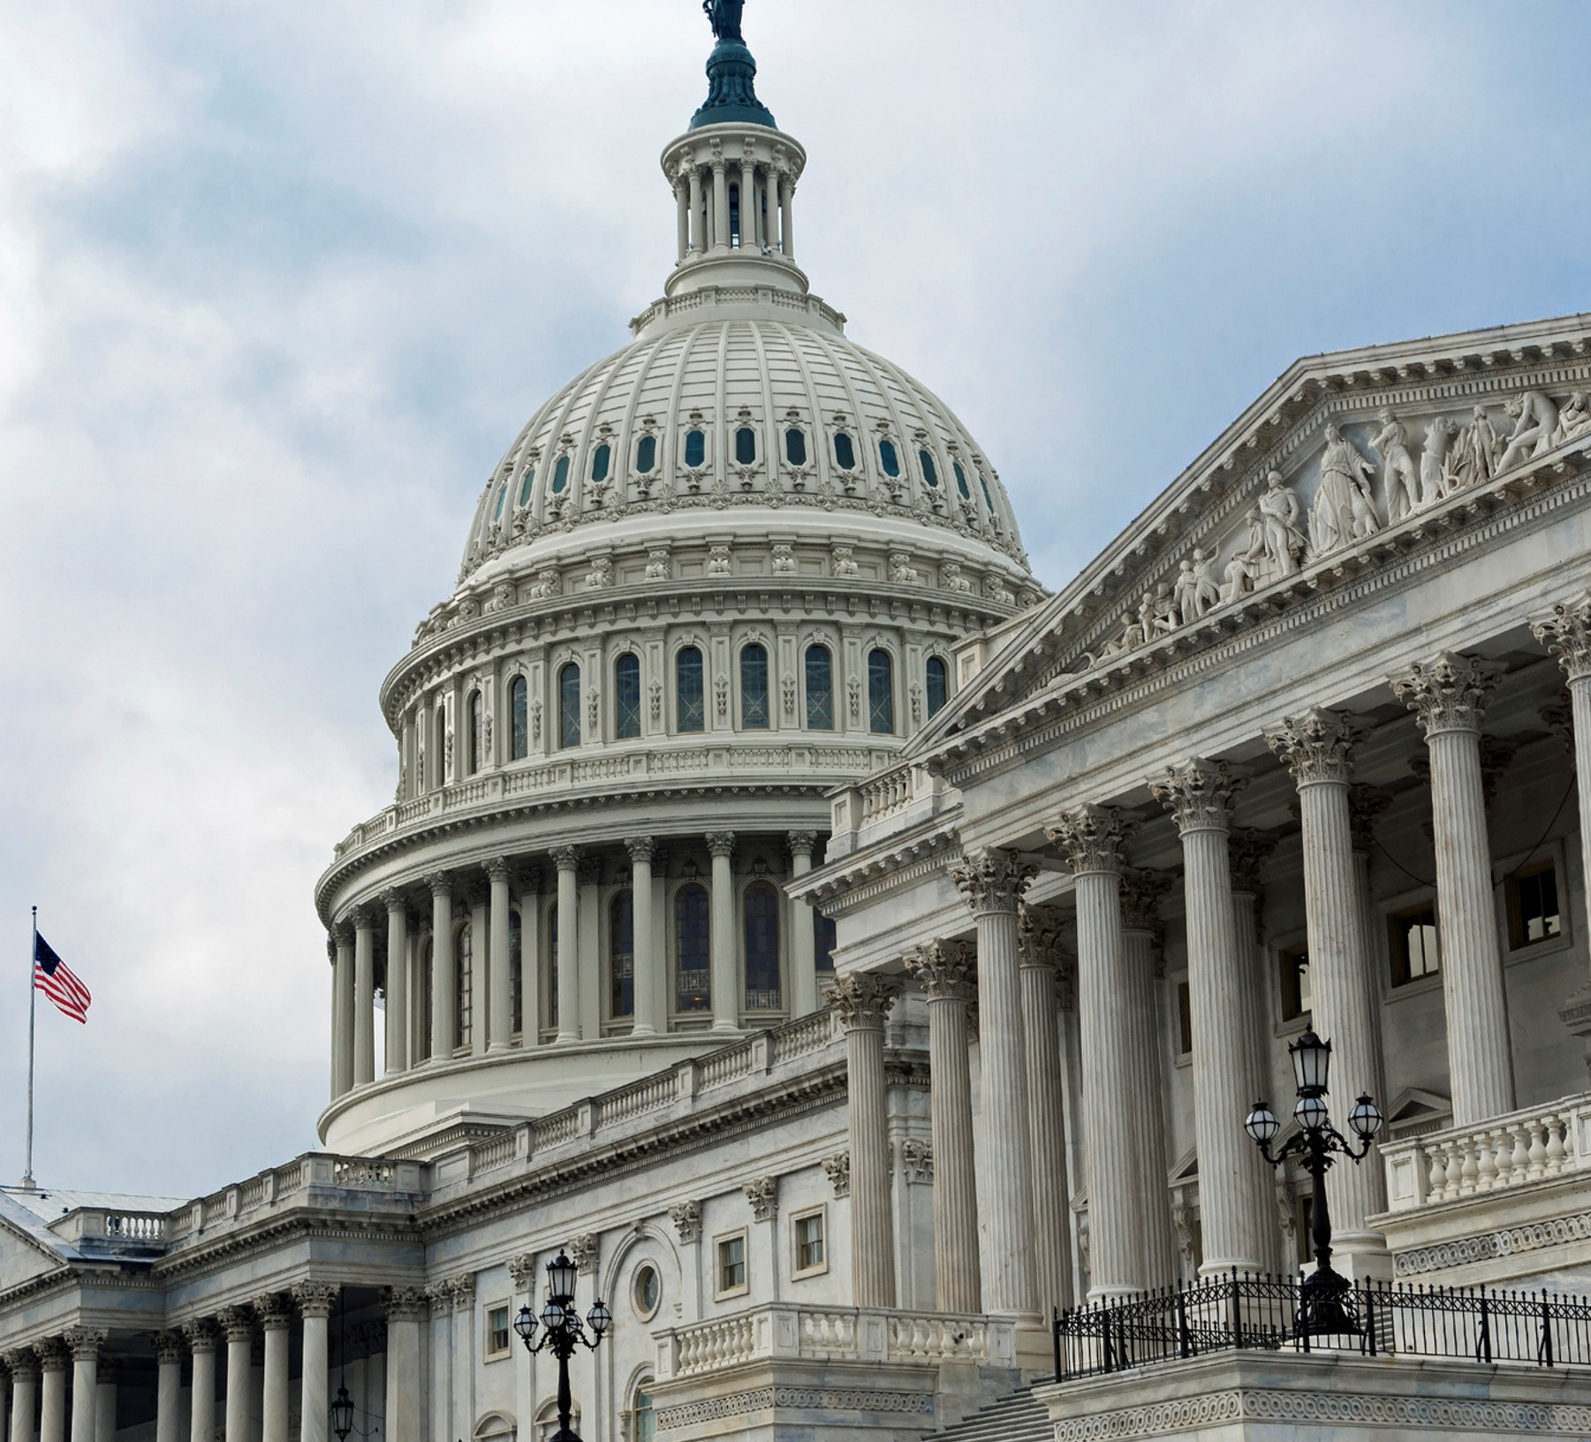
CDR Credential vs
State Licensure
What is the Difference?
© 2026 Academy of Nutrition and Dietetics

Slide 11
Definitions
CDR Credential
State Licensure
A professional credential awarded to individuals who have completed specific academic and supervised practice requirements and passed the CDR exam.
Most states require RDs and other nutrition professionals to hold a state license or certification to legally practice or use state-specific protected titles. Requirements vary from state to state.
© 2026 Academy of Nutrition and Dietetics
Notes:
The CDR credential is A professional credential awarded to individuals who have completed specific academic and supervised practice requirements and passed the CDR exam.
State licensure on the other hand doesn’t have a single definition. However, most states require RDs and other nutrition professionals to hold a state license or certification to legally practice or to use state-specific protected titles. Unlike the CDR credential, state licensure Requirements vary from state to state.

Slide 12
Key Areas of Difference
State License
CDR Credential
Eligibility Requirements
Consistent Across States
Complete required academic and supervised practice requirements, and pass the CDR exam
Differs by State
Categories
Differs by State
Categories include license, certification, and title protection
Consistent Across States
CDR administers two primary credentials, the RD and the DTR
Maintenance Requirements
Consistent Across States
Pay annual maintenance fee and complete/submit at least 75 CPEUs (RD) every 5 years
Differs by State
Recognition
May be required to hold more than one state license if providing services in multiple states
Nationally Recognized
https://www.cdrnet.org/LicensureMap
© 2026 Academy of Nutrition and Dietetics
Notes:
You’ll see that the CDR credential has specific eligibility requirements that are consistent across all states, whereas state licensure differs by state. A state may offer accelerated pathways to become licensed or certified, such as the endorsement of your RD credential, reciprocity or endorsement of licensure in another state, and/or temporary or provisional licenses that may allow you to practice without a license for a limited time or in certain circumstances.
You can also see that maintenance requirements for state licensure differ state to state and that holding a state license/certification only allows you to practice in that state, whereas the RDN credential is nationally recognized.
In any case, CDR and the Academy strongly recommend that practitioners hold licensure or certification in all states where their clients or patients are located when services are provided, except in cases where exceptions/exemptions apply or when a state has no requirements for licensure or certification.

Slide 13
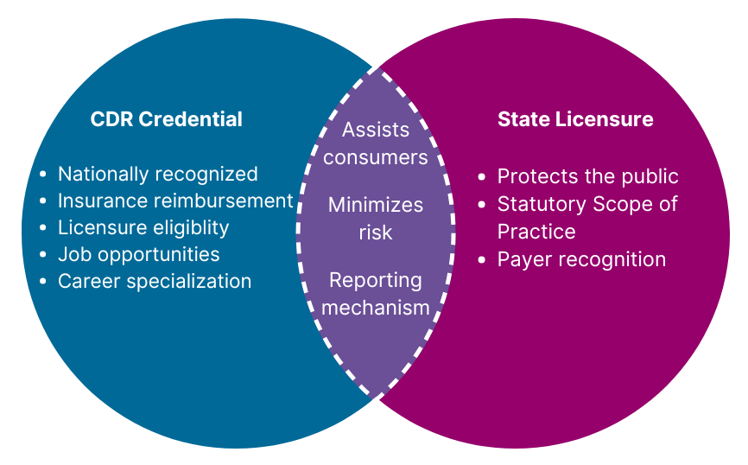
Benefits
© 2026 Academy of Nutrition and Dietetics
Notes:
Having the RDN credential provides many unique benefits for practitioners, including providing
automatic eligibility for state licensure
Expanded Job Opportunities, as the credential is required for many positions
Eligibility for some types of Insurance Reimbursement
On the same note, state licensure also offers some unique benefits, as it
Regulates entry into the profession by identifying qualified and competent practitioners
allow RDs to provide MNT in certain states, without which RDs may not have legal authority to do so
may be required by government or private insurance providers to identify qualified providers eligible to receive reimbursement
Both the CDR credential and state licensure
Help the public identify individuals with the required knowledge, skills, and competency to provide safe and effective care
Helps consumers receive safe and accurate information and/or interventions that prevent poor or even dangerous health outcomes
And provides Mechanisms to report: fraudulent, unethical, or harmful activity and to impose penalties when necessary

Slide 14

Case Study
© 2026 Academy of Nutrition and Dietetics
Notes:
The final section of this practice tool will highlight a case study in which an RDN will use the Scope of practice decision algorithm to determine whether she can provide MNT services via interstate and cross-border telehealth.

Slide 15
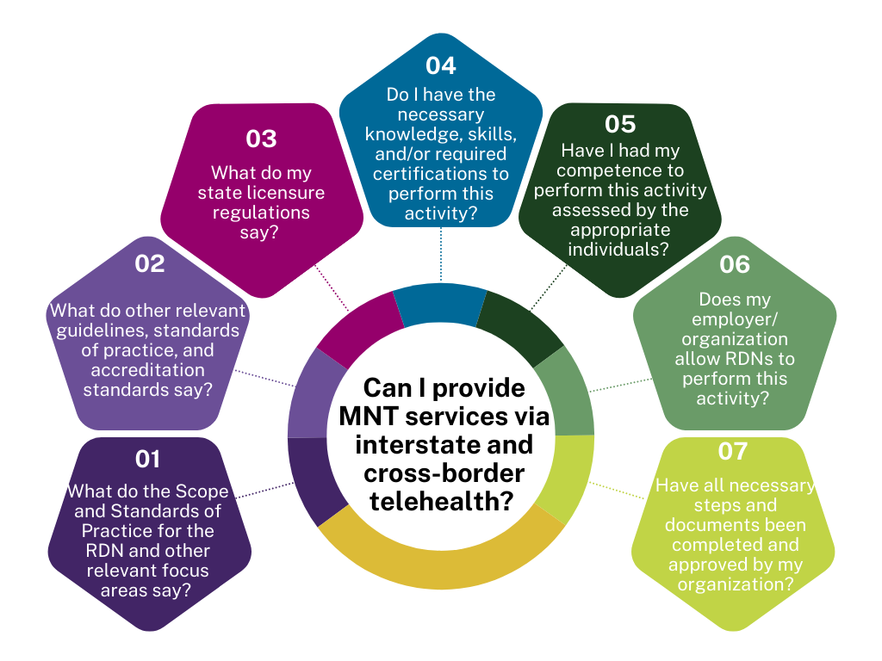
Case Study Using the Scope of Practice Decision Algorithm
© 2026 Academy of Nutrition and Dietetics
Notes:
Annie is an RDN working in a hospital in Minnesota, providing outpatient nutrition counseling services. She has recently begun to offer telehealth services to patients using satellite clinics within the state and she has also been receiving an increasing number of referrals for patients who reside in the neighboring state of North Dakota. Annie would like to determine if she can safely and legally provide MNT-related services via telehealth to patients in both states.
Using the Scope of Practice Decision Algorithm, Annie answers a series of questions to determine whether this activity is within her individual scope of practice.
To answer question 1, Annie reviews the 2024 Revised Scope and Standards of Practice for the RDN for relevant information pertaining to providing MNT services via telehealth.

Slide 16
Case Study Using the Scope of Practice Decision Algorithm
© 2026 Academy of Nutrition and Dietetics
Notes:
To answer question 2, Annie reviews resources, such as any applicable nutrition practice guidelines, national, facility and/or program accreditation standards, and the Academy/CDR Code of Ethics for relevant information and finds nothing that would prohibit her from providing telehealth services based on her unique situation and setting.

Slide 17
Case Study Using the Scope of Practice Decision Algorithm
© 2026 Academy of Nutrition and Dietetics
Notes:
To answer question 3, Annie reviews state licensure laws and stateus and discovers that both Minnesota and North Dakota regulate the practice of dietetics require licensure to practice. Annie confirms that there are no telehealth-specific credentials or formal training required to provide telehealth in either state.
Because laws and regulations are regularly updated, Annie understands that she will need to monitor applicable laws and regulations for both states, as well as regulations for general telehealth (non-nutrition specific).

Slide 18
Case Study Using the Scope of Practice Decision Algorithm
© 2026 Academy of Nutrition and Dietetics
Notes:
To answer Question 4, Annie uses the Scope and Standards of Practice for the RDN to assess her knowledge and skills and determines that she may need additional training and knowledge concerning the telehealth-specific regulations and payment issues.
She discusses these goals with her supervisor and reviews appropriate resources for additional training opportunities

Slide 19
Case Study Using the Scope of Practice Decision Algorithm
© 2026 Academy of Nutrition and Dietetics
Notes:
To answer question 5, Annie reviews relevant indicators from the 2024 Scope and Standards of Practice for the RDN, as well as those from focus area Scope and Standards of Practice articles applicable to her patient/client population
She determines that there are indicators for which she does not meet the competent level of practice and seeks out opportunities to strengthen her knowledge and skills to ensure quality practice.
Since her supervisor and other members of the interprofessional team have experience delivering MNT through telehealth, Annie requests training on telehealth best practices and technology, as well as using the HIPAA-compliant video conferencing platform. Once training is complete Annie’s supervisor verifies and document her competency and stores the records in Annie’s employee personnel file.

Slide 20
Case Study Using the Scope of Practice Decision Algorithm
© 2026 Academy of Nutrition and Dietetics
Notes:
To answer question 6, Annie reviews her organization’s governing body documents, such as medical staff bylaws, rules and regulations, and policies and procedures, and concludes that telehealth is allowed with appropriate training and documented competence.
After her competence is verified, documented, and saved in her personnel file, Annie works to ensure that her job description is amended to support performing these new activities.

Slide 21
Case Study Using the Scope of Practice Decision Algorithm
© 2026 Academy of Nutrition and Dietetics
Notes:
And finally, to answer question 7. Annie reviews the CMS regulations for performing MNT via telehealth and the reimbursement codes.
She confirms that the hospital where she works is considered a “distant sites” and can be reimbursed for telehealth, and that she is listed as a distant site practitioner.

Slide 22
The Scope of Practice Decision Algorithm can be found at https://www.eatrightpro.org/practice/scope-and-standards-of-practice
While this case study reviewed the application of the Decision Algorithm to a specific practice scenario, this tool is designed to be used across all practice areas and settings.
© 2026 Academy of Nutrition and Dietetics
Notes:
The Scope of Practice Decision Algorithm can be found on the Academy Scope Webpage.
While this case study reviewed the application of the Decision Algorithm to a specific practice scenario, this tool is designed to be used across all practice areas and settings.

Slide 23
Thank You!
Questions? Email scope@eatright.org.
Notes:
Thank you for attending. Please email questions to scope@eatright.org

