Slide 1


Practice Tools
Supervision and Autonomy
Notes:
Welcome to Practice Tools on Supervision and Autonomy.

Slide 2
Supervision and Autonomy in the RDN-NDTR Team
The following are common question asked by RDNs/NDTRs , particularly when working with other practitioners to deliver nutrition care and services:
Which activities can be performed autonomously?
Which activities need supervision?
What are the requirements for cosigning?
Determining the individual scope of practice and competence of each member of the nutrition team is required to answer these questions.
Navigating the RDN-NDTR Team
What is the process for cosigning?
Which activities can be performed autonomously?
Which activities need supervision?
© 2026 Academy of Nutrition and Dietetics
Notes:
The following are common question asked by RDNs/NDTRs , particularly when working with other practitioners to deliver nutrition care and services:
Which activities can be performed autonomously?
Which activities need supervision?
What are the requirements for cosigning?
Determining the individual scope of practice and competence of each member of the nutrition team is required to answer these questions.

Slide 3
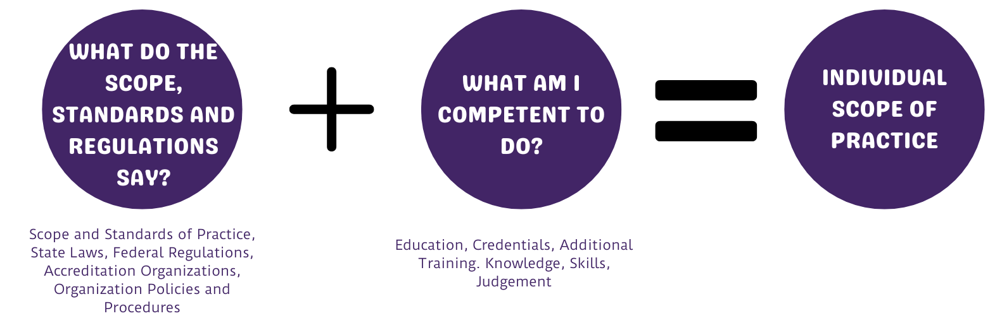
Individual Scope of Practice
The term “Individual Scope of Practice” is used consistently throughout the literature and in practice, but many practitioners don’t have a clear understanding of what their scope of practice entails.
© 2026 Academy of Nutrition and Dietetics
Notes:
The term “Individual Scope of Practice” is used consistently throughout the literature and in practice, but many practitioners don’t have a clear understanding of what their scope of practice entails.
You can think of your individual scope of practice is a set professional tasks/activities that you are allowed to do based on what is specified in the laws, regulations, policies, standards, etc., as well as, what you are competent to do based on your current knowledge and skills. The next slide reviews the components that determine your individual scope of practice.

Slide 4
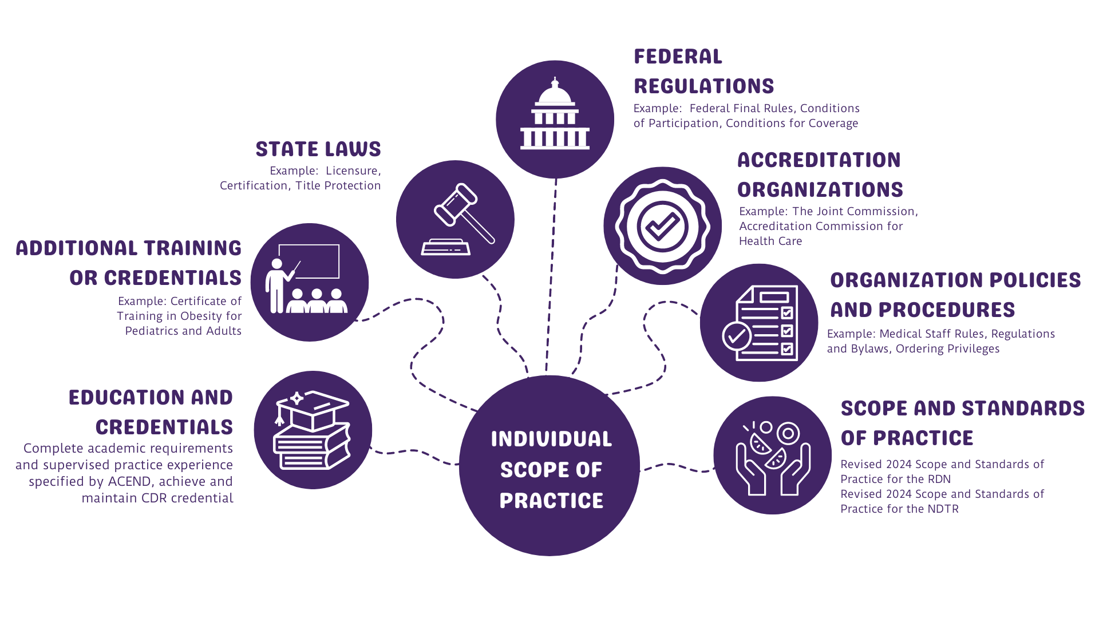
Individual Scope of Practice Diagram
© 2026 Academy of Nutrition and Dietetics
Notes:
Individual scope of practice is the intersection point of: Revised 2024 Scope and Standards of Practice; State Laws; Education and Credentials; Federal and State Regulations and Interpretive Guidelines; Accreditation Organizations; Organizational Policies and Procedures; and Additional Individual Training/Credentials/ Certifications.
Depending on the activity, situation and/or setting, your scope of practice may differ. For example, some states require licensure to practice and provide MNT, and policies will vary from organization to organization.

Slide 5
NDTRs and Autonomy
While the NDTR must work under the supervision of the RDN when providing direct nutrition care in a clinical setting, they may work independently when providing general nutrition education and other services to healthy populations.
When working autonomously, it is essential that the NDTR:
understands and adheres to the Code of Ethics, which highlights the importance of recognizing one’s limits of qualifications and when appropriate, collaborate, seek counsel, and make referrals, and
assesses their individual scope of practice to determine the specific tasks/activities can be done autonomously.
The decision tree on the next slide walks an NDTR through questions that can help with this.
© 2026 Academy of Nutrition and Dietetics
Notes:
While the NDTR must work under the supervision of the RDN when providing direct nutrition care in a clinical setting, they may work independently when providing general nutrition education and other services to healthy populations.
When working autonomously, it is essential that the NDTR understands and adheres to the Code of Ethics, which highlights the importance of recognizing one’s limits of qualifications and when appropriate, collaborate, seek counsel, and make referrals.
The decision tree on the following slide can help assess whether, and in which situations, an NDTR can work independently. This information is particularly important for the NDTR working as a solo practitioner without direct access to an RDN for consultation and referral.

Slide 6
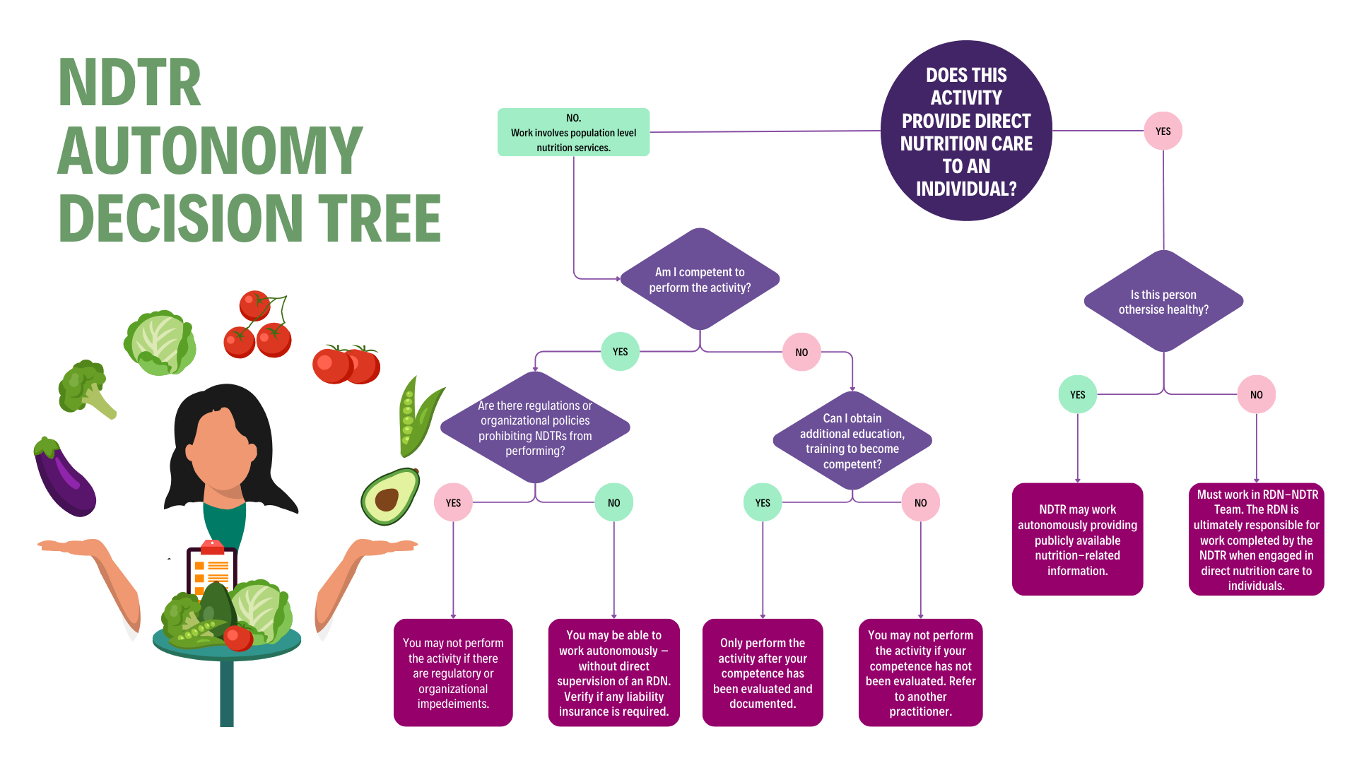
NDTR Autonomy Decision Tree
© 2026 Academy of Nutrition and Dietetics
Notes:
The NDTR must first ask - does this activity provide direct nutrition care to an individual. If yes, they need to determine whether the individual is otherwise healthy. If the person is, then they may be able to work autonomously with publicly available nutrition related information. If not, and the individual has identified conditions or diseases, the NDTR must work in an RDN-NDTR team.
If the NDTR answers no to the first question and they work at the population level, they must determine whether they are competent to perform the desired activity. If they are, the NDTR should review all relevant regulations, and organizational policies or procedures to determine if anything prohibits them from performing the activity. If nothing exists, they may be able to work autonomously.
If the NDTR identifies they are not competent, they must seek out additional training to gain competency before performing the task. If no such training exists, they must refer to another practitioner.

Slide 7

What does Supervision mean?
The definition of supervision is contextual. It varies by setting, by profession, and by intent. For example, supervision may be categorized as to whether it is managerial, clinical, personal, or professional. Further, an individual’s experience in a work setting with supervision may affect their understanding of who a supervisor is and what supervision entails.
The NDTR and other professional, technical, and support staff work under the clinical supervision of the RDN when engaged in direct patient/client nutrition care activities in any setting.
© 2026 Academy of Nutrition and Dietetics
Notes:
The definition of supervision is contextual. It varies by setting, by profession, and by intent. For example, supervision may be categorized as to whether it is managerial, clinical, personal, or professional. Further, an individual’s experience in a work setting with supervision may affect their understanding of who a supervisor is and what supervision entails.
The NDTR and other professional, technical, and support staff work under the clinical supervision of the RDN when engaged in direct patient/client nutrition care activities in any setting.
The following slides provide an overview and some common examples of tasks within the Nutrition Care Process and other Workflow Elements that can be designated by the RDN, as well as details about the process and helpful resources for assessing scope of practice.
The RDN is responsible for nutrition care: work delegated to and completed by NDTRs and other staff, the RDN is accountable to the patient/client, employer/organization, and regulator.
Federal and state rules and regulations for health care facilities: the qualified dietitian must supervise the nutritional aspects of patient care and provide nutrition assessments and dietary counseling.
State dietitian/nutritionist practice acts and regulations: may define supervision, and if applicable, statutory scope of practice specifications for technical and other assistive staff.
NDTRs working in skilled or long-term care facilities: work in collaboration with the staff or consultant RDN to address a resident's diet- or nutrition-related orders, including when the physician has delegated diet order writing to the RDN.

Slide 8
NDTR’s Role in the NCP and Workflow Elements
Nutrition Screening | Review nutrition screening completed by others or obtain and document screening data
Nutrition Assessment | Per RDN request or standard procedure, obtain and document specified data to contribute elements of the nutrition assessment or reassessment for completion by the RDN
Nutrition Diagnosis | Per RDN-assigned task, communicate and provide input to the RDN
Nutrition Intervention/ Plan of Care | Implement/oversee standard operating procedures; assist with implementation of individualized patient/client/customer interventions and education as assigned by the RDN
Nutrition Monitoring & Evaluation | Implement/oversee duties performed by other nutrition and foodservice staff; monitor patient/client tolerance and acceptance of meals, snacks, nutritional supplements; document per procedure; and report to the RDN and other team members the results and observations of monitoring activities
Discharge Planning and Transition of Care | Assist with or provide information as assigned by the RDN
© 2026 Academy of Nutrition and Dietetics
Notes:
This table highlights some of the tasks that may be delegated and supervised by the RDN, given the NDTR’s scope of practice allows

Slide 9
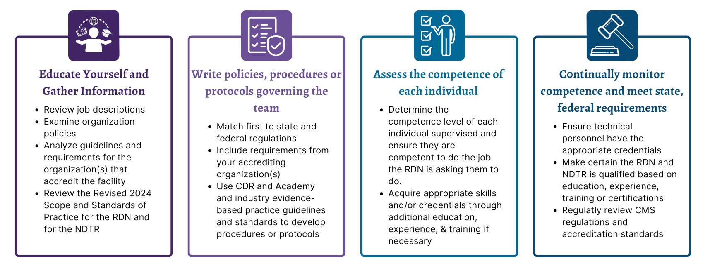
STEPS to Create and Optimize the RDN-NDTR Team
© 2026 Academy of Nutrition and Dietetics
Notes:
There are four main steps to create and optimize the RDN-NDTR Team:
Educate yourself and gather information such as job descriptions, and organization policies
Write policies, procedures or protocols governing the team, matching state and federal regulations, industry based scope and standards or practice and evidence based guidelines
Assess the competence of each individual, suggesting additional training or experience if needed to perform the requested activity
Continually monitor competence and meet state and federal regulations

Slide 10

When to Cosign
In clinical settings when data is entered into a medical record by “others” (eg, other RDNs, NDTRs, unlicensed and/or non-credentialed practitioners, or students/interns), the supervising RDN may be required to cosign.
This signature implies that the RDN has assigned, is responsibility for, and has approved the care provided to patients/clients.
© 2026 Academy of Nutrition and Dietetics
Notes:
In clinical settings when data is entered into a medical record by “others” (eg, other RDNs, NDTRs, unlicensed and/or non-credentialed practitioners, or students/interns), the supervising RDN may be required to cosign.
This signature implies that the RDN has assigned, is responsibility for, and has approved the care provided to patients/clients.
The following slides provide an overview of how to determine the process for cosigning in various settings/situations and assessing scope of practice.

Slide 11

What to consider when developing a cosigning policy
Has the RDN evaluated the individual’s competence to perform the assigned activity?
Have new staff, students/inters and educators been trained on when and how EHR entries are cosigned?
Has the level of access to medical records been determined as well as RDN cosignatory and documentation records?
Have the appropriate individuals within the organization such as Human Resources, Medical Records, Risk Management, Other Discipline Heads or Quality and Regulatory Compliance been consulted?
Have all appropriate accreditation standards or state or federal laws and regulations been reviewed and addressed? (eg, CMS definition of ‘qualified dietitian’, cosigning timeline, state licensure)
© 2026 Academy of Nutrition and Dietetics

Slide 12
How to Cosign
What if there are notes to the documentation?
The cosigner may add to the notes entered by the student or intern but should not edit the notes. With a pending co-signature note in EHR, the preceptor may be able to have student/intern make a correction or include missing information if needed and then re-sign the note.
How to Sign?
Student/intern should cosign notes with first initial, last name, Student Dietitian or Dietetic Intern and university name (may be abbreviated) or as specified in procedure for EHR or paper chart. In EHR, it is common for student/intern to check “Cosign” button so that note is pending preceptor co-signature.
After reviewing and verifying the note, the preceptor/staff RDN signs note with first initial, last name and credentials, e.g., R. Doe, RDN. Both the student/intern and the RDN signatures will show.
© 2026 Academy of Nutrition and Dietetics
Notes:
How to Cosign?
What if there are notes to the documentation?
The cosigner may add to the notes entered by the student or intern but should not edit the notes. With a pending co-signature note in EHR, the preceptor may be able to have student/intern make a correction or include missing information if needed and then re-sign the note.
How to Sign?
Student/intern should cosign notes with first initial, last name, Student Dietitian or Dietetic Intern and university name (may be abbreviated) or as specified in procedure for EHR or paper chart. In EHR, it is common for student/intern to check “Cosign” button so that note is pending preceptor co-signature.
After reviewing and verifying the note, the preceptor/staff RDN signs note with first initial, last name and credentials, e.g., R. Doe, RDN. Both the student/intern and the RDN signatures will show.

Slide 13
When to Cosign
The individual not yet registered and/or licensed, as applicable, should always work under the clinical supervision of the RDN.
Cosign NOT Required
Cosign Required
Dietetic Extern
Dietetic Intern
ISPP Intern
Student
Registration Eligible to become an RDN
Registration Eligible to become an NDTR
Yes, for when practice competencies assessment has determined need for further education to attain competence
Credentialed Practitioner
© 2026 Academy of Nutrition and Dietetics
Notes:
The table on this slide represents when a cosign is not required and when a cosign is required. Generally speaking if an individual is not yet registered and/or licensed as applicable, that individual should always work under the clinical supervision of the RDN.

Slide 14
Thank You!
Questions? Contact scope@eatright.org

