Slide 1


Ordering Privileges and Delegated Orders
Notes:
Welcome to this video, which is a Practice Tool highlighting topics related to the regulations addressing RDN order writing through privileging in hospital settings or delegated orders in skilled or long-term care facilities or other community settings such as physician offices or clinics.

Slide 2
Table of contents
Delegated Orders for Long-Term Care Facilities
1
Hospital Regulations on Ordering Privileges
2
Implementation Steps
3
Navigating CMS Regulations
4
© 2026 Academy of Nutrition and Dietetics
Notes:
This presentation will highlight how to pursue RDN ordering privileges or delegated orders along with a separate Case Study video that provides a hypothetical example of one hospital’s process where the RDNs do have some ordering privileges just not ones for parenteral or enteral nutrition support.

Slide 3

Delegated Orders- LTC
The Long-Term Care Final Rule, published October 4, 2016
Resulted in significant changes to the CMS State Operations Manual (SOM) Appendix PP LTC regulations effective November 2017.
Outlined the attending physician may delegate prescribing a resident’s diet to a qualified dietitian or other clinically qualified nutrition professional.
© 2026 Academy of Nutrition and Dietetics
Notes:
For non-hospital settings, the Long-Term Care Final Rule effective November 2017 would allow an attending physician in a skilled or long-term care facility to delegate diet order writing to a qualified dietitian or other clinically qualified nutrition professional as defined by state law.
This process would also support physicians in community settings asking RDNs to write orders or can order a physician-initiated protocol, a process often used in a free-standing dialysis center, for example.
As with hospital RDN privileging, it is important to check state laws and regulations to verify there are no barriers to RDNs writing orders in these settings.

Slide 4

Hospital Ordering Privileges
May 12, 2014, Federal Register Final Rule effective July 11, 2014
The Rule impacted the hospital regulations in the CMS State Operations Manuals (SOM) (Appendix A-Hospital; W-Critical Access Hospital) Conditions of Participation (CoPs).
The Rule allows hospitals the option of granting order writing privileges to qualified dietitians or clinically qualified nutrition professionals if consistent with state law.
© 2026 Academy of Nutrition and Dietetics
Notes:
For hospitals, the 2014 FINAL RULE provided a significant change for RDNs practicing in hospital settings. Hospitals now have the option of implementing ordering privileges for qualified dietitians or clinically qualified nutrition professionals if consistent with state law.
Regulations in the CMS State Operations Manuals for hospitals Appendix A and for critical access hospitals Appendix W were updated to call out qualified dietitians and other clinically qualified nutrition professionals as “non-physician practitioners” eligible for ordering privileges.

Slide 5
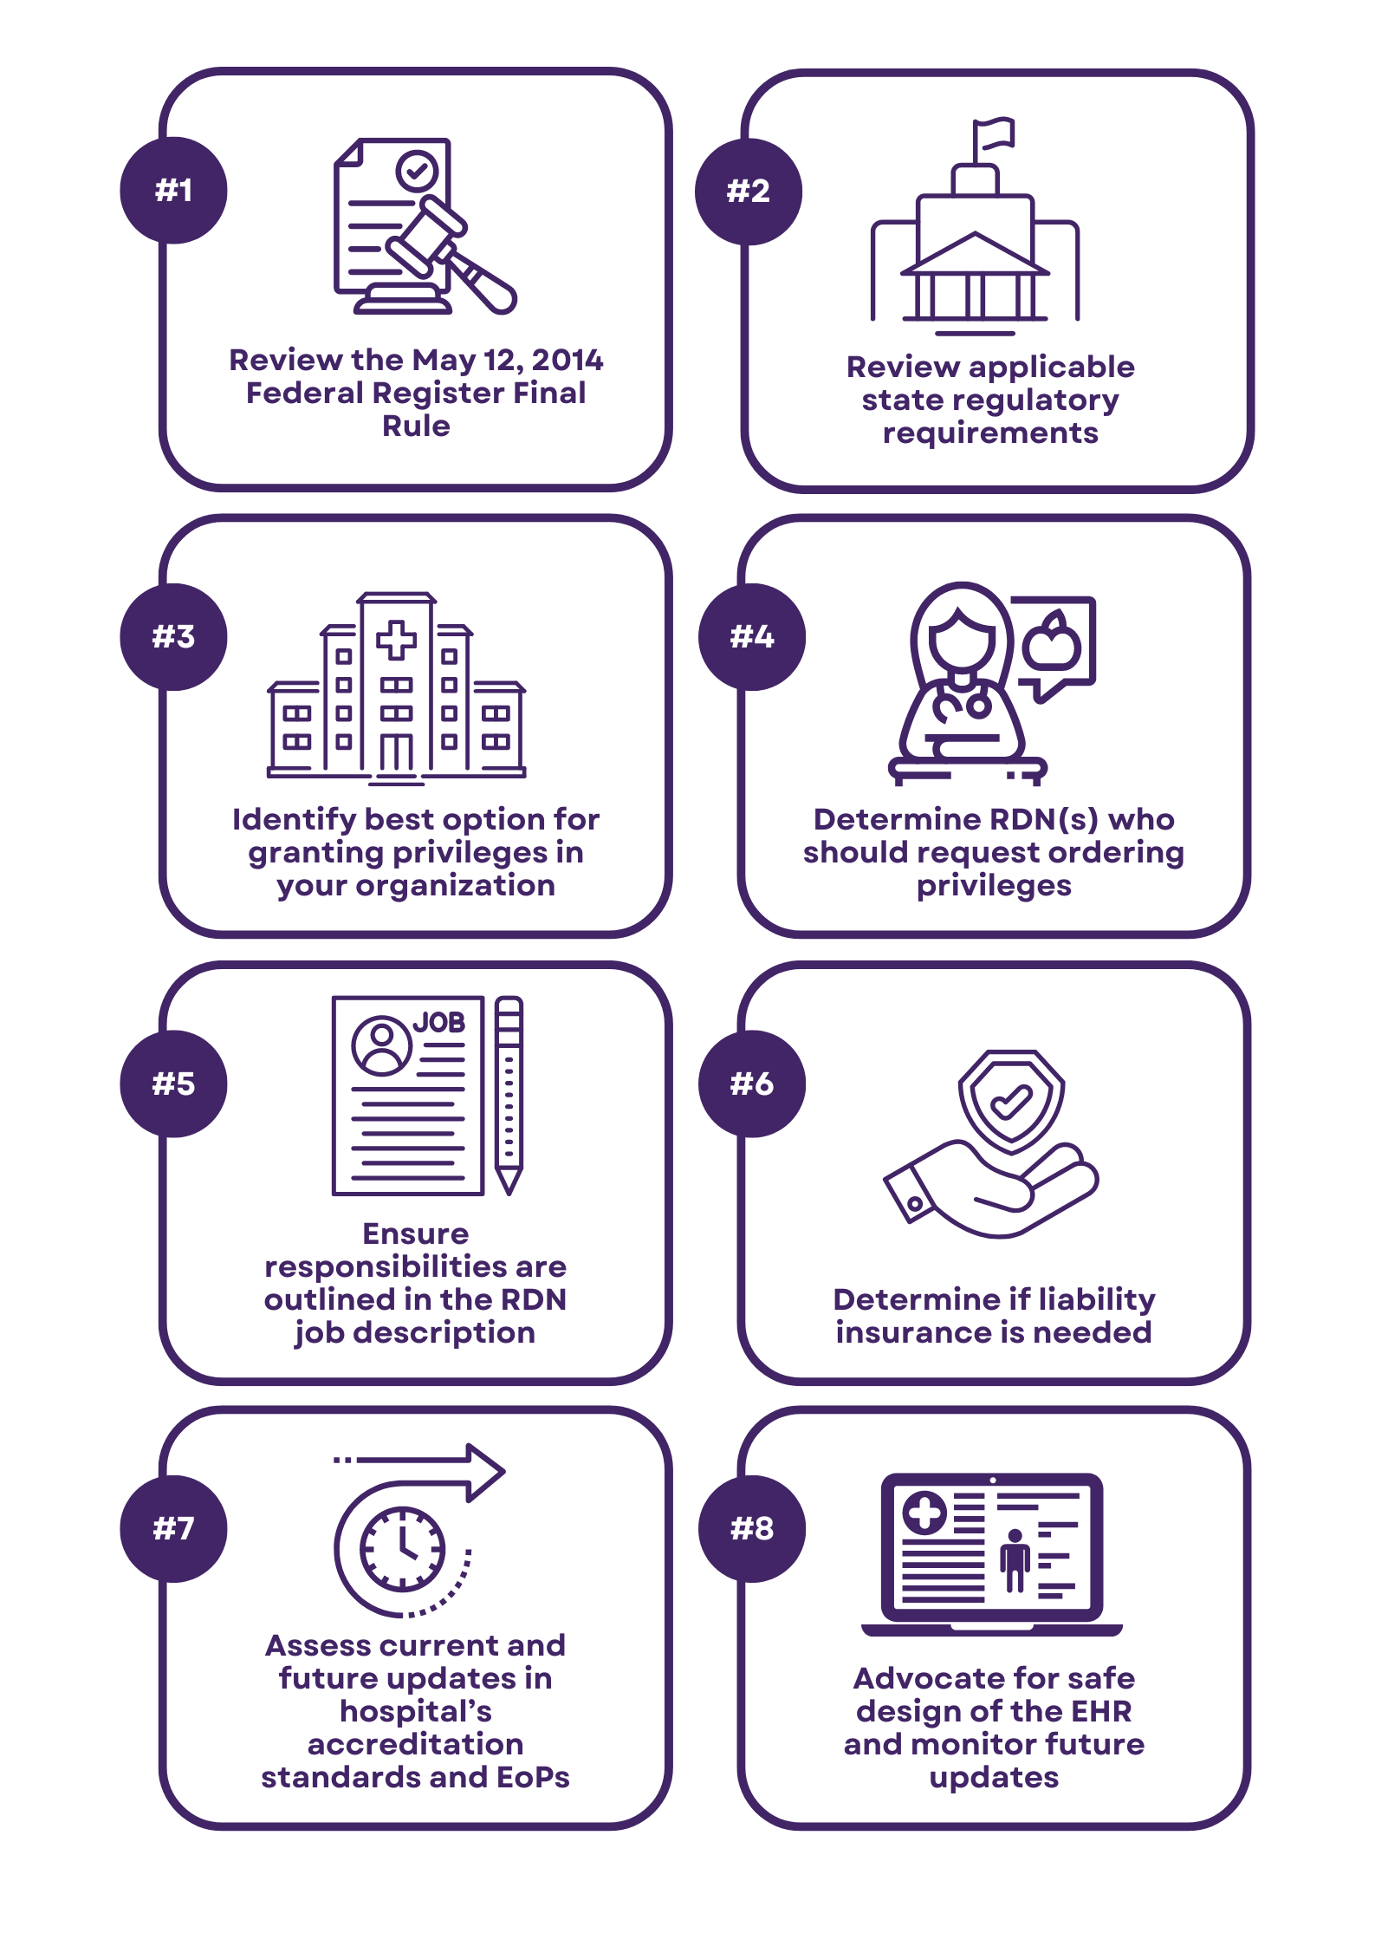
Implementation Steps
© 2026 Academy of Nutrition and Dietetics
Notes:
The next slides will go though steps 1-8 on this slide to identify a process to consider to pursue ordering privileges in hospital settings.

Slide 6
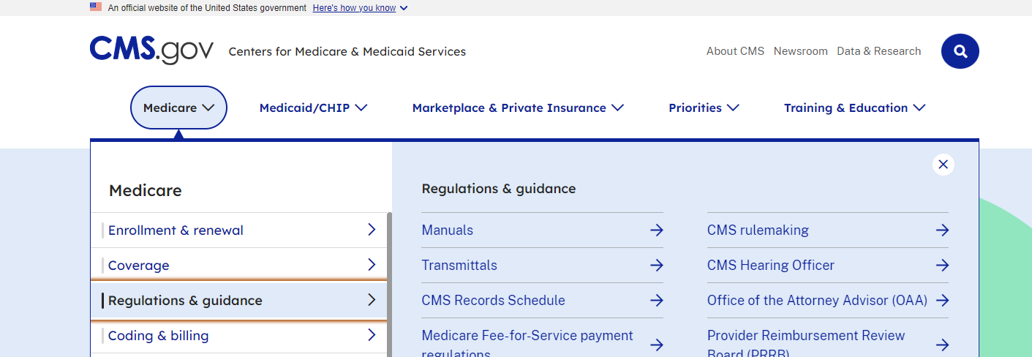
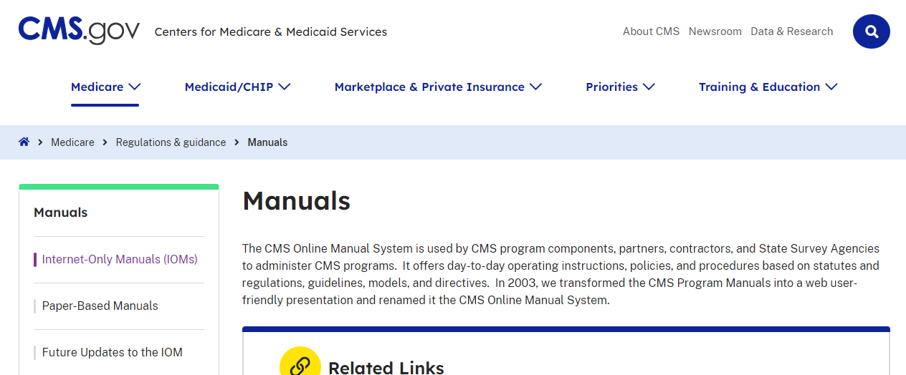
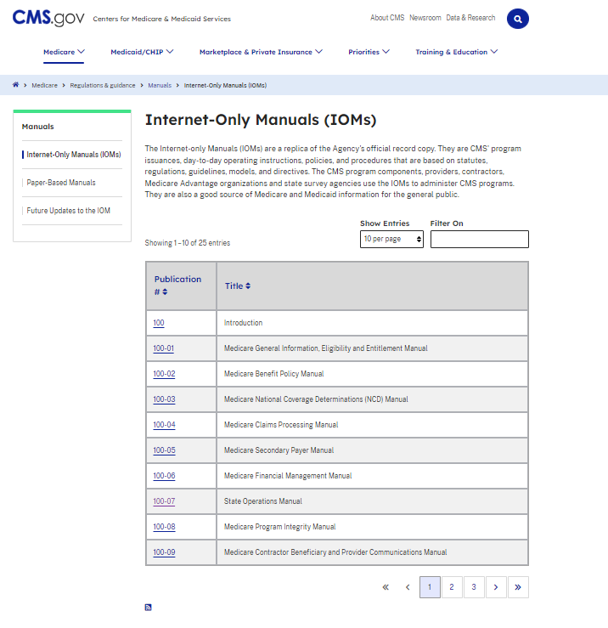
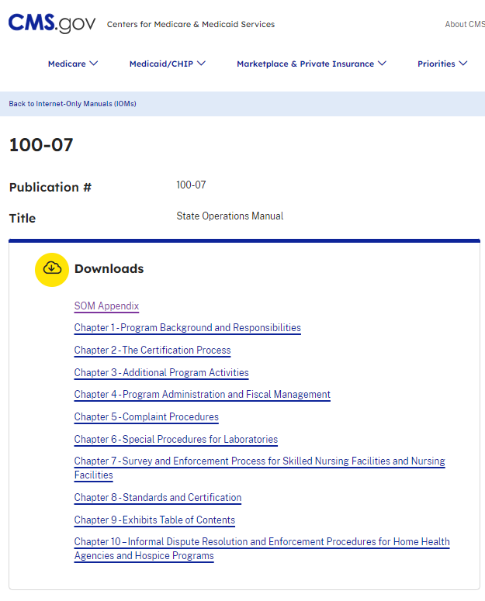
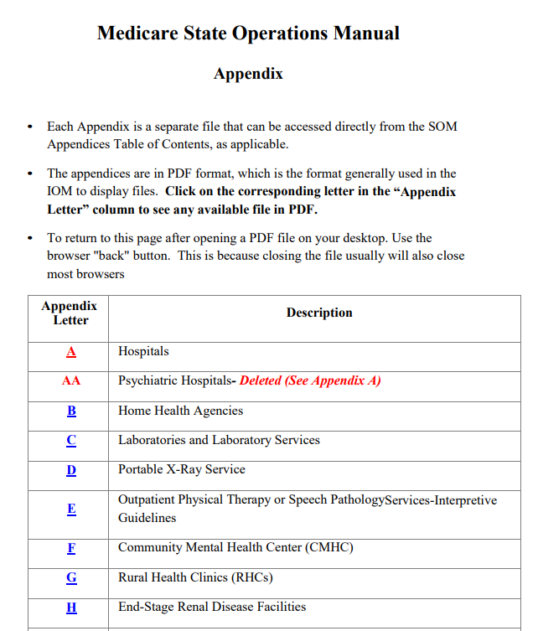
How to Navigate
    https://www.cms.gov/files/document/som-appendix.pdf
© 2026 Academy of Nutrition and Dietetics
Notes:
First, review the hospital regulations. This slide will walk you through where to locate the CMS State Operations Manuals on the CMS website.
Access regulations from CMS website at www.cms.gov:
Click on Medicare at the top left
In left column, click on:
Regulations & Guidance
Manuals – Internet only Manuals in left column
Scroll down to Publication #100-07 State Operations Manual
In list of Chapters, click on SOM Appendix at the top
Click on desired manual
A=Hospitals, W=Critical Access Hospitals, PP=Long-Term Care Facilities
H=End-Stage Renal Disease Facilities, M=Hospice, X=Organ Transplant Programs
Don’t forget – check for any state regulations applicable to any of these settings
OR Put link to CMS State Operations Manuals in your computer Bookmarks. Link is at the bottom right of slide.
https://www.cms.gov/files/document/som-appendix.pdf

Slide 7
How to Navigate- Key Tips
Periodically check for updates – Revision number and Issue Date for new updates are in red under “Table of Contents” at the top of the first page of the regulations
Search by regulation or TAG number – Examples – Appendix A Hospitals:
    §482.22(a), Tag A-0339 Appointment to Medical Staff - Non-physician practitioners
    §482.28, Tag A-0618 Food and Dietetic Services
    §482.28(b)(2), Tag A-0630 Ordering Therapeutic Diets - Qualified Dietitian
Search by “dietitian” and “dietician”; food, nutrition, privileging
Look for latest update wording changes in red type
© 2026 Academy of Nutrition and Dietetics
Notes:
It is important to periodically check for updates if your hospital does not routinely notify key staff when there are regulation updates.
The manuals have many pages, so it is time efficient to develop a method for searching sections applicable to dietitians, food and nutrition or other sections of interest. Examples are listed for searching in Appendix A Hospitals.
Dietitian could be spelled with a “c” depending on date of the regulation so check by both spellings.
Look for wording in RED type.
These tips would apply to any of the State Operations Manuals although for some, foodservice-related regulations may not apply.

Slide 8
Thank you!
Questions? Email scope@eatright.org.
Notes:
Thank you. If you have any questions, send an email to quality@eatright.org.
Please also take the opportunity to review the Practice Tips located in “Navigating Ordering Privileges and Delegated Orders” on the CDR website at www.cdrnet.org/tips that are associated with this presentation.

