Slide 1

Interprofessional Collaboration and Advanced Practice
Notes:
Welcome to this video, which is a Practice Tool highlighting topics related to interprofessional collaboration and advanced practice for the RDN and NDTR.

Slide 2
Table of contents
Collaborative practice
1
Advanced practice
2
Case studies
3
© 2026 Academy of Nutrition and Dietetics
Notes:
A Practice Tool can be comprised of any Practice Tips, Case Studies, short videos, or infographics.
Practice tips aid in navigating practice by providing resources and asking critical, thought-provoking questions.
Case studies demonstrate the application of the Scope of Practice Decision Algorithm to practice scenarios. The example scenarios provide guidance, resources and options that can be used to evaluate whether the specific task is within the credentialed nutrition and dietetics practitioner’s individual scope of practice.
This video will cover the topics of collaborative and advanced practice and a case study.

Slide 3
Collaborative Practice
Interprofessional collaborative practice (IPCP), and avoiding working in professional silos, is the expectation in healthcare settings to reduce medical errors, improve communication and coordination among health care professionals, and improve health outcomes.
© 2026 Academy of Nutrition and Dietetics
Notes:
In healthcare settings, particularly hospitals, collaborative practice is the expectation. It facilitates team members sharing information and planning care more efficiently with the goal of improved health outcomes.
Interprofessional collaboration isn’t limited to healthcare settings. Credentialed nutrition and dietetics practitioners are integral members of the interprofessional team and team leaders in:
Preventative care and wellness
Foodservice systems
Culinary and retail
Military, first responders and the US Public Health Services
Sustainable food and water systems and
Education and research.

Slide 4

Standard 4.2.1
RDNs and NDTRs:
Contributes to or seeks opportunities to build relationships and networks to facilitate collaboration, and promotes referral systems to:
• Credentialed nutrition and dietetics practitioners
• Other health-related services (eg, social worker)
• Social, community and health-related services or resources (eg, housing, food resources, community action agencies)
© 2026 Academy of Nutrition and Dietetics
Notes:
As the minimum competent standard, RDNs and NDTRs contribute to or seek opportunities to build relationships and networks to facilitate collaboration, and promote referral systems to:
• Credentialed nutrition and dietetics practitioners
• Other health-related services such as a social worker and
• Social, community and health-related services or resources (eg, housing, food resources, community action agencies)
Focus area standards may expand upon this concept to explain the nuance of collaborative practice in specific areas.

Slide 5
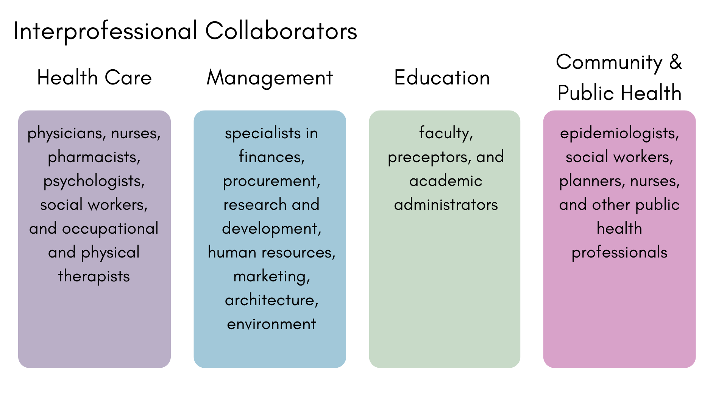
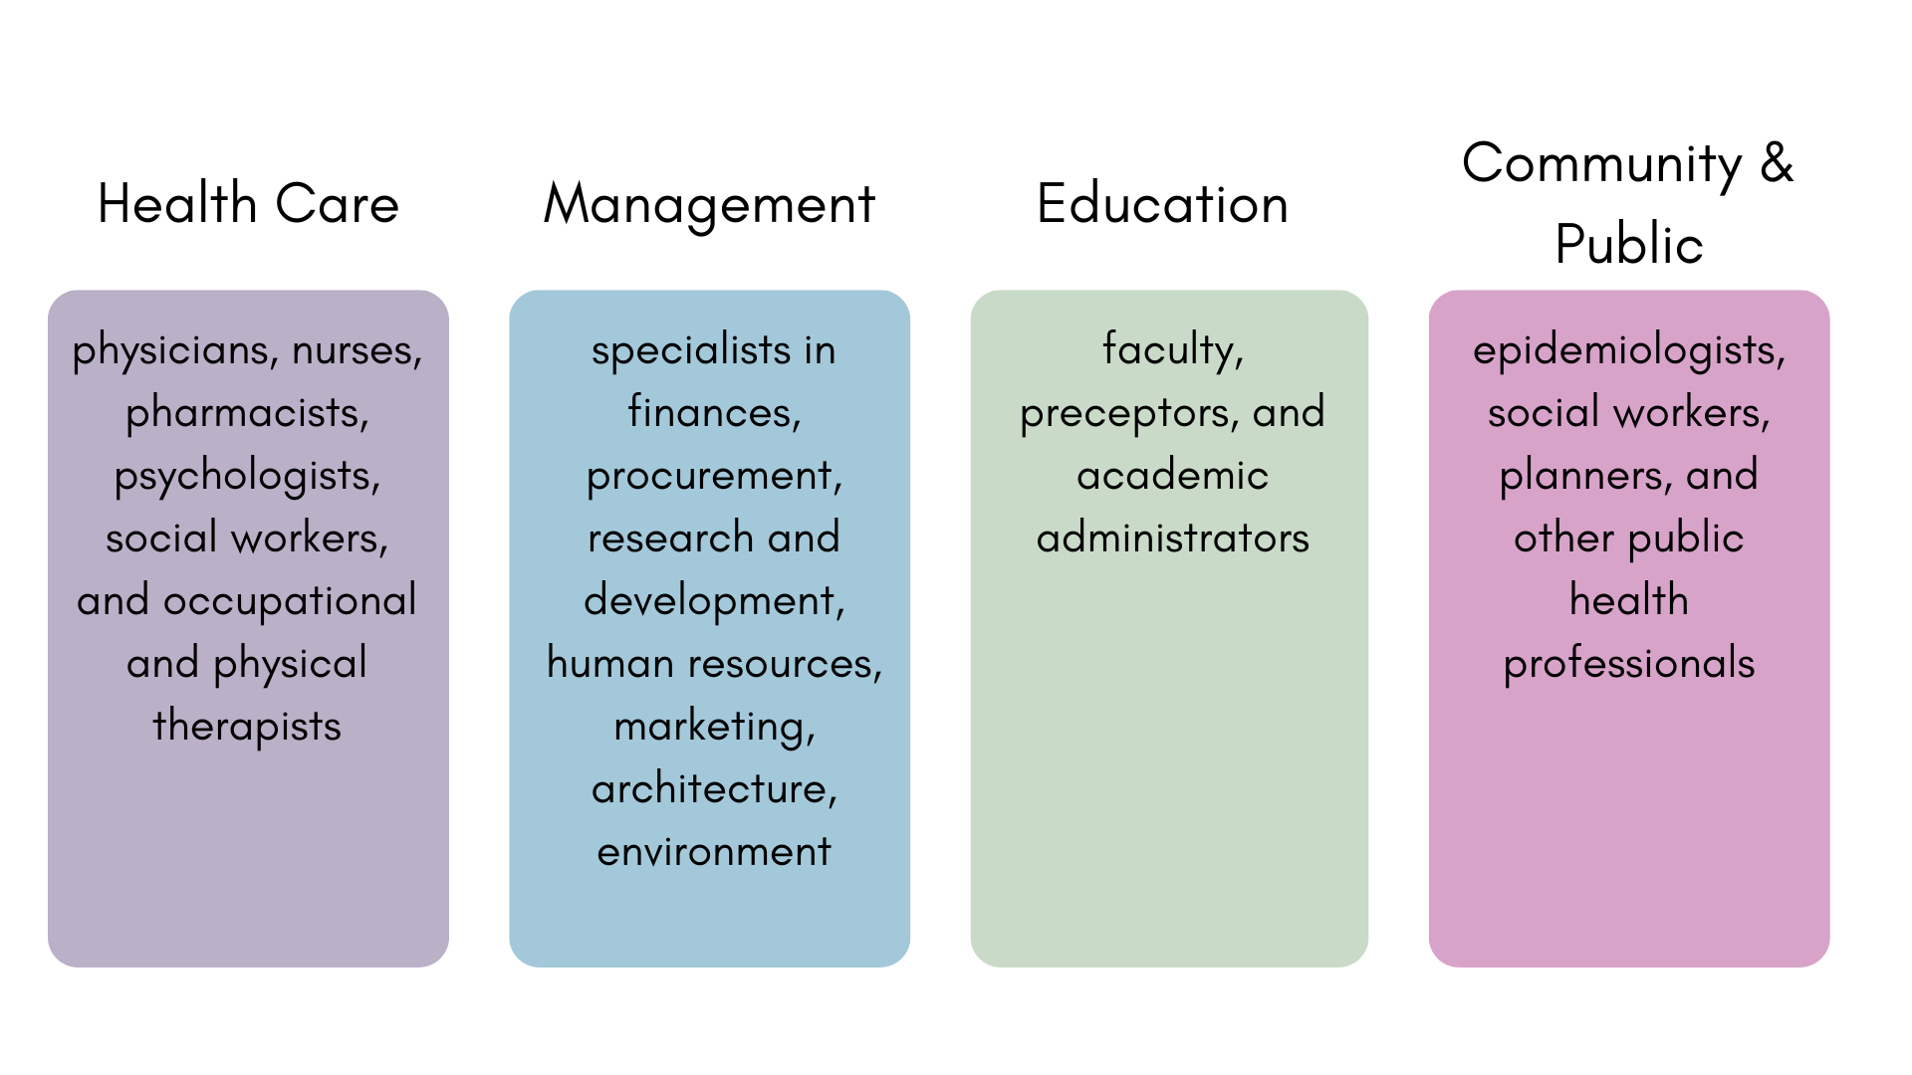
Interprofessional Collaborators
© 2026 Academy of Nutrition and Dietetics
Notes:
Interprofessional collaboration is the goal in all practice settings. Collaboration with team members enables RDNs and NDTRs to highlight their roles and become integral members of their teams.. Examples of teams include:
Healthcare, where RDNs and NDTRs may work with physicians, nurses, pharmacists, psychologists, social workers, and occupational and physical therapists
Management, where RDNs and NDTRs may work with finance, procurement, research and development, human resources, marketing, architecture, and environment
Education, where RDNs and NDTRs may work with faculty, preceptors and academic administrators and
Community and Public Health, where RDNs and NDTRs may work with epidemiologists, social workers, planners, and other public health professionals

Slide 6

Advanced Practice
Practicing at an advanced level requires specific
knowledge,
skills, and
specialized training
beyond core education and supervised practice
© 2026 Academy of Nutrition and Dietetics
Notes:
As you think about your career goals, what activities would be considered advanced practice in your area specialty? Answering this question will help determine what knowledge, skills and practice experience is needed. Advanced training and/or a related specialty certification is typically required by employers to work with patients with complex care needs or of a specific population group.
Familiarity with practice guidelines, evidence-based research and information, and leadership and collaborative team-based care with members of the interprofessional team is characteristic of beyond entry-level practice.
At times, it is important for safety and quality of care to recognize when assistance is needed or to facilitate referral to an RDN or other healthcare professional with appropriate competence and expertise.

Slide 7
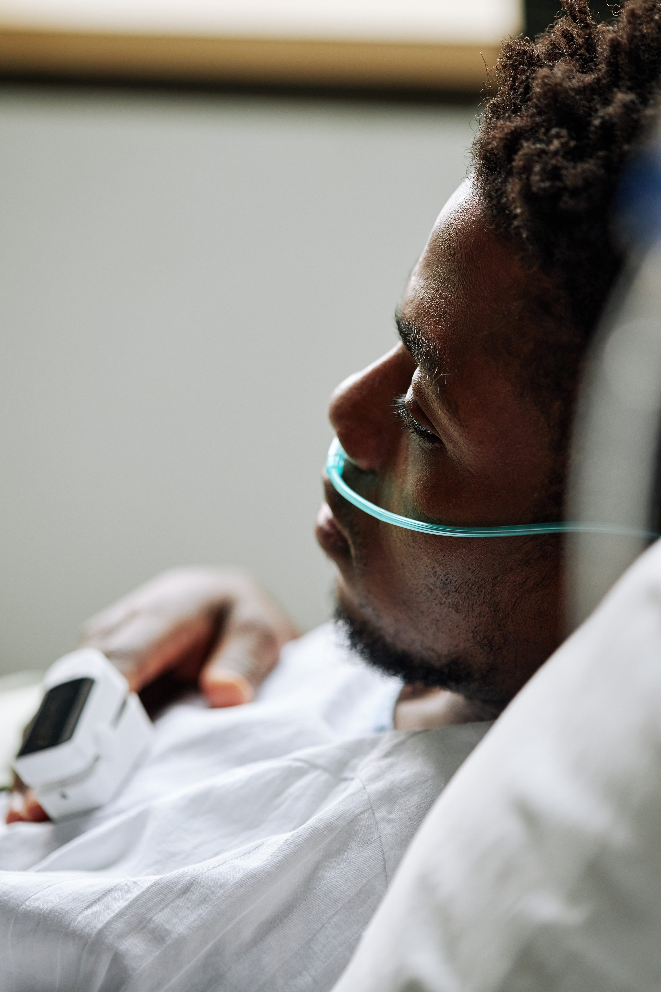
Examples of Advanced Clinical RDN Practice
Insertion of nasoenteric feeding tubes
Counseling for pre-diabetes, interpreting data and adjusting continuous glucose monitoring [CGM] devices, insulin pumps, and diabetes-related technology
Conducting and interpreting bedside ultrasound to assess muscle changes
Developing and implementing wound prevention, skin management, and nutritional wound intervention programs
Psychosocial screening, monitoring for disordered eating and sleep health
Managing individuals with eating disorders, inborn errors of metabolism, or organ transplants
www.eatrightpro.org/practice/scope-and-standards-of-practice/focus-area-scope-and-standards-for-rdns
© 2024 Commission on Dietetic Registration
Notes:
This slide provides some examples of advanced practice activities where specialized knowledge and skills are needed for safe and quality practice. If any of these activities are of interest, investigate available resources to determine what is necessary to become competent to perform an activity as a means of advancing your practice.
More information on these advanced practices can be found in Focus Area Standards.

Slide 8
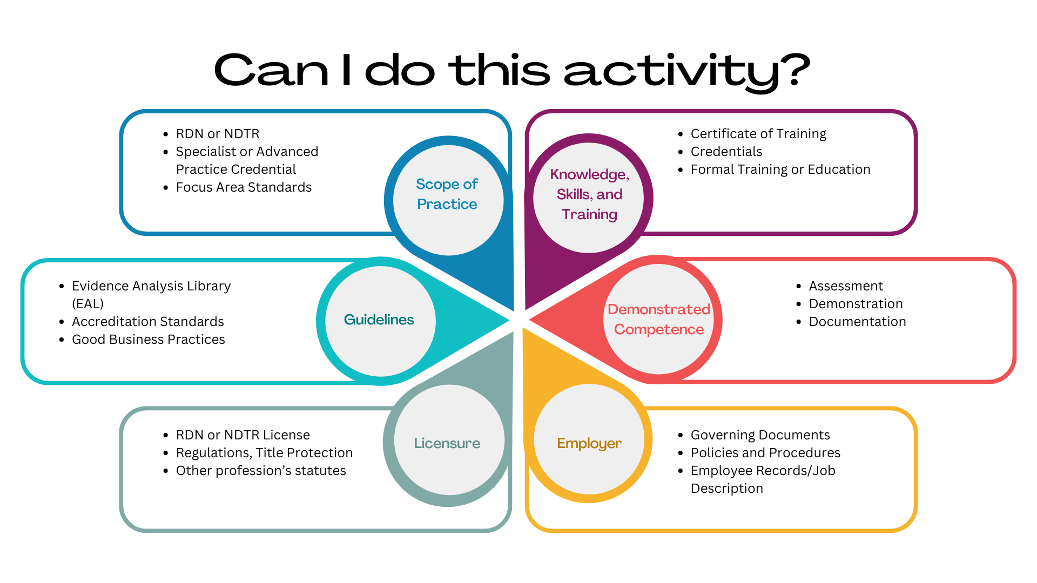
Can I do this activity?
© 2026 Academy of Nutrition and Dietetics
Notes:
The CDR Scope of Practice Decision Algorithm provides a process for self-evaluation to determine if a desired activity is within a RDN’s or NDTR’s individual scope of practice by answering a series of questions. The algorithm is designed to allow a RDN or NDTR to critically evaluate their knowledge, skills, experience, and demonstrated and documented competence.
Components of the algorithm include the questions:
Do the Scope and Standards of Practice contain information that provides guidance on whether the practitioner can perform this activity?
Does this activity align with nutrition practice guidelines (eg, EAL); other national organization standards of practice and/or practice guidelines; accreditation standards; federal and state regulations; CMS conditions of participation or conditions for coverage; and facility/program accreditation standards applicable to the setting or population and good business practices (eg, Code of Ethics)?
If the state(s) where you work license RDNs and NDTRs, is there any language that prohibits the activity? Is there language in any other profession’s statute and regulations that would prohibit an RDN or NDTR performing the activity?
Do you have the necessary knowledge, skills, training (including certificates of training or required certification[s] (Common Credentials for RDNs and NDTRs) to perform the activity?
Have you demonstrated your ability to perform the activity competently to an individual with the knowledge and skills to appropriately assess your competence to perform the activity according to accepted standards including those for the required certification? Is that evaluation documented in your personnel record?
Does your employer/organization in its governing documents, policies and procedures, or other documents (eg, medical staff bylaws, rules, and regulations; medical director-approved policy or protocol) recognize the credential (eg, RDN, NDTR, or specialist credential[s]) held as authorized to perform the activity?

Slide 9

Case Studies
Case studies demonstrate the application of the Scope of Practice Decision Algorithm to practice scenarios.
Advanced Practice Case Studies:
Expanding RDN Practice
Screening for Swallowing Difficulty by RDNs
NDTRs and Health and Wellness Coaching
The Scope of Practice Decision Algorithm can be found at www.eatrightpro.org/practice/scope-and-standards-of-practice
© 2026 Academy of Nutrition and Dietetics
Notes:
Case studies demonstrate the application of the Scope of Practice Decision Algorithm to practice scenarios.
The example scenarios provide guidance, resources and options that can be used to evaluate whether the specific task is within the credentialed nutrition and dietetics practitioner’s individual scope of practice.
Advanced practice case studies include
Expanding RDN Practice
Screening for Swallowing Difficulty by RDNs
NDTRs and Health and Wellness Coaching

Slide 10
Thank you!
Questions? Email scope@eatright.org.
Notes:
Thank you! Please send questions to scope@Eatright.org.

