Slide 1


Case Study:
Expanding Hospital Ordering Privileges
Notes:
Welcome to this video, which is a Practice Tool and case study that illustrates a hospital’s process for expanding the list of ordering privileges already available to the hospital’s registered dietitians.

Slide 2

Case Study
A hospital-based RDN who primarily sees individuals with malnutrition and other comorbidities desires privileges to write independent orders for nutrition support-related activities (e.g., parenteral nutrition [PN] and enteral nutrition [EN], and insertion and monitoring of nasogastric and nasoenteric feeding tubes).
© 2026 Academy of Nutrition and Dietetics
Notes:
In this example, a RDN practicing in a 300-bed community hospital who primarily sees patients with malnutrition or other complex comorbidities has privileges to write diet-related orders. The RDN is wanting to expand their privileges to include independent ordering of parenteral and enteral nutrition and eventually insertion and monitoring of nasogastric and nasoenteric feeding tubes.

Slide 3
Background
Ordering EN or PN or inserting and monitoring nasogastric or nasoenteric feeding tubes are not currently in the list of ordering privileges for diets or nutrition-related services available to this hospital’s RDNs.
For privileges to independently order EN and PN and perform advanced procedures such as insertion and monitoring of nasogastric or nasoenteric feeding tubes, an RDN must determine if the desired activity(es) is within their individual scope of practice.
© 2026 Academy of Nutrition and Dietetics
Notes:
The hospital approved privileging for RDNs about 3 years ago but, the list of privilege options does not include
independent ordering privileges for enteral or parenteral nutrition or insertion of feeding tubes.
Since these privileges might be viewed as advanced practice, the RDN and any of the other RDNs on staff would need to determine
if these privileges would be within their individual scope of practice.

Slide 4
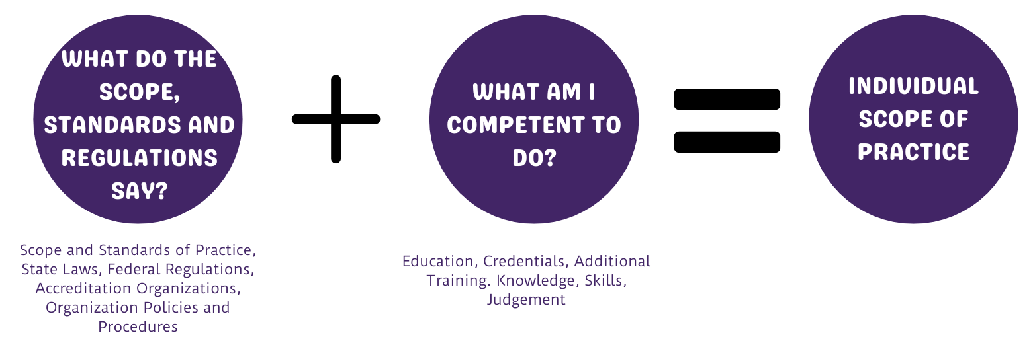
Case Study
Prior to beginning the implementation steps to pursue addition of privileges to independently order PN or EN and for performing insertion and monitoring of nasoenteric feeding tubes, the RDN first ensures the desired activities are within their individual scope of practice.
© 2026 Academy of Nutrition and Dietetics
Notes:
This RDN is personally interested in the new privilege options as they have experience on the nutrition support team, recently obtained the CNSC certification and is pursuing training to become competent in inserting and monitoring nasoenteric feeding tubes.
Discussions with Nutrition Support Team physicians and advanced practice nurse colleagues provided support for becoming qualified to insert feeding tubes as this would help with more timely initiation of therapy.
Other staff RDNs expressed interest as well, particularly for independently ordering EN and PN.

Slide 5
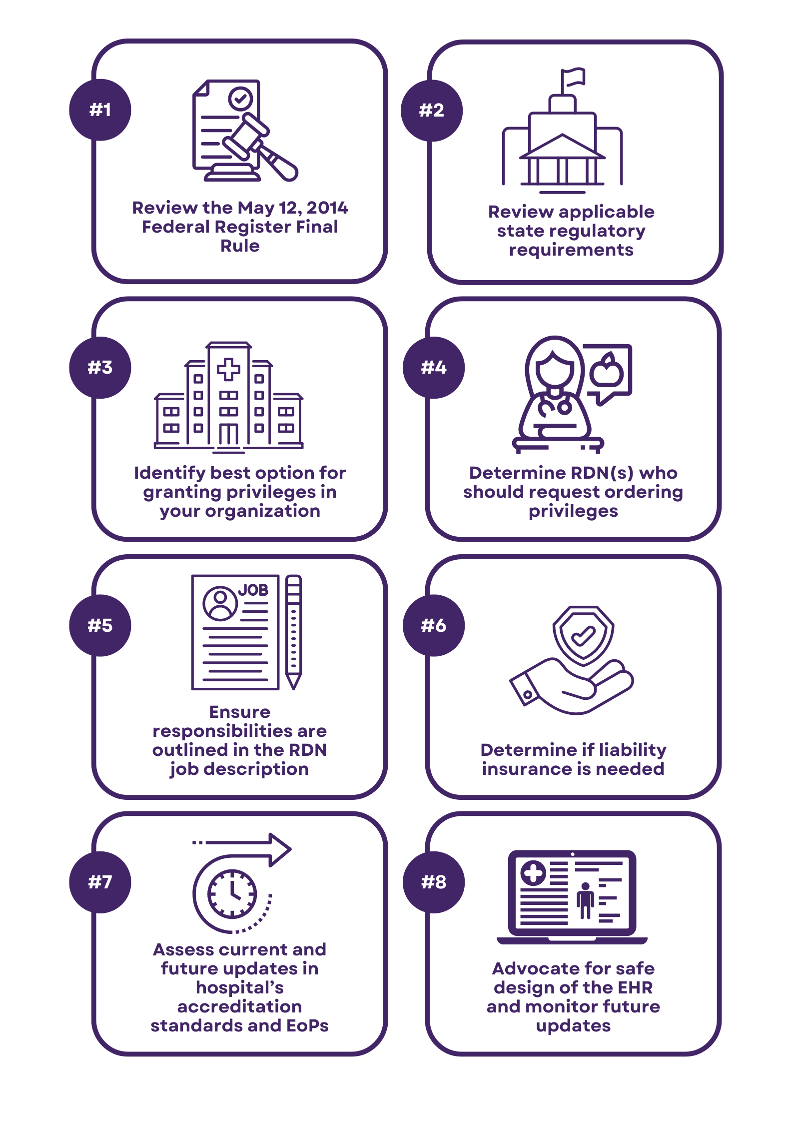
Case Study
RDN and Clinical Nutrition Manager:
Reviewed documentation when privileges were first granted to RDNs
Verified there are no barriers present in current federal and state hospital regulations and hospital’s accreditation organization standards
Identified process for requesting additional privilege options
Obtained NST physician support and willingness to serve as the “physician champion”
Collected peer-reviewed journal articles that speak to the value of RDNs ordering EN or PN or inserting feeding tubes
© 2026 Academy of Nutrition and Dietetics
Notes:
To prepare for discussions with physician leadership, the RDN and the Clinical Nutrition Manager:
reviewed the documentation collected and presented to the medical staff when RDN privileging was first adopted.
double checked federal and state hospital regulations and the hospital’s accreditation standards to verify that no changes have been made
that would impact the addition of the new privilege options
inquired of the Medical Staff office, the process for requesting addition of new privileges to the existing list of RDN privilege options
And, to support formal request to the medical staff, the RDN began developing a list of journal articles that could be cited

Slide 6
Case Study
Discussions with RDN staff included:
Rationale and benefits of the new privilege options
Required knowledge, skills, and experience
Potential need for and benefit of having or obtaining a specialty certification such as the CNSC or CSR according to the patient population served
Perspective of the NST physician champion
Responding to questions about training that could be provided, how competency would be assessed
© 2026 Academy of Nutrition and Dietetics
Notes:
Several staff meetings addressed …. (read list on slide) (say “CNSC or Certified Nutrition Support Clinician” or CSR “Certified Specialist in Renal”)
The clinical nutrition manager met with each RDN individually to determine level of interest in writing independent orders for EN and PN and for becoming qualified to insert and monitor nasogastric and nasoenteric feeding tubes.
Several RDNs new in practice did not yet have enough experience to write independent orders; they expressed interest and desired mentoring to become qualified.

Slide 7
Case Study
Discussion included a review of the 2021 Standards of Practice in Nutrition Care and Standards of Professional Performance for RDNs in Nutrition Support.
Information and supporting citations in the article Overview and the indicators in the Standards support the qualified RDN writing EN and PN orders and inserting feeding tubes.
Levels of practice – competent, proficient and expert
    Ordering PN is proficient level
    Inserting feeding tubes is expert level
Illustrates knowledge, skills, experience and demonstrated competence critical to providing safe care
Access NS Standards at cdrnet.org/focus to self-assess knowledge, skills, experience in nutrition support
© 2026 Academy of Nutrition and Dietetics
Notes:
Staff discussion also included a review of the current Standards of Practice and Standards of Professional Performance for RDNs in Nutrition Support.
The Standards support a qualified RDN being able to order EN or PN or insert feeding tubes.
The review of the indicators in the 3 levels of practice indicate that ordering PN is minimally proficient level and inserting feeding tubes is expert level.
Careful review of the Nutrition Support Standards provided needed knowledge and guidance on what you need to do to minimally be competent and then what you need to be able to do to be considered proficient or expert level of practice in nutrition support therapies.
Access all the focus area standards at cdrnet.org/focus.
Use the Nutrition Support Standards to self-assess knowledge, skills and experience to help determine if qualified for independent order writing or what areas require additional knowledge, skills and practice experience to advance level of practice.

Slide 8
Case Study
The medical staff approved the addition of the new privilege options to the list of privileges available to the hospital’s RDNs with the stipulation that the RDN needs to have the CNSC certification to write PN orders.
The position descriptions for the RDNs who were approved to write independent PN and/or EN orders were updated.
It was recommended that the RDNs writing independent PN and/or EN orders investigate the need for professional liability insurance.
The RDN initiating the request for writing independent PN and EN orders qualifies because of having the CNSC certification and will now complete training to become competent in inserting and monitoring feeding tubes.
© 2026 Academy of Nutrition and Dietetics
Notes:
The RDN and the clinical nutrition manager worked together to compile the supporting information and develop the memo requesting the addition of the 3 new privilege options.
The clinical nutrition manager met with the Medical Staff Coordinator to review the memo in preparation for the next medical staff leadership committee meeting.
The clinical nutrition manager and the RDN attended the committee meeting to respond to questions including:
Pointing out the Nutrition Support Standards for RDNs that specifically address ordering enteral and parenteral nutrition and inserting feeding tubes
Addressing the benefits of having the CNSC certification. The RDN described the qualifications for sitting for the certification exam and how they personally benefitted from the education and the impact on patient assessments and orders written for approval by the physician which is current process.
The Medical Staff committee approved the addition of the new privilege options with stipulation that a RDN needs to have the CNSC certification to write PN orders.
Position descriptions for applicable RDNs were updated.
Benefit of professional liability insurance were reviewed.
And the RDN who pursued the new privileges can now write independent orders and is completing training to become competent in inserting feeding tubes.

Slide 9
Case Study
Next steps…
The RDN and the Clinical Nutrition Manager plan to meet with IT contact to review EHR design to see if any adjustments are needed now that some RDNs will have independent ordering privileges.
Current system already has the option of pending orders so that physician can approve orders written by RDN for EN or PN.
Clinical nutrition manager will monitor federal and state regulations and accreditation standards for any changes impacting independent order writing.
Once RDNs begin writing independent orders, the clinical nutrition manager will collect data to share with physician champion.
© 2026 Academy of Nutrition and Dietetics
Notes:
Next steps include:
Verifying that EHR design supports RDN independent order writing.
Continue with use of pending orders for staff not yet qualified to write independent orders and for use with students/interns who are learning to write orders.
Clinical nutrition manager will continue to monitor federal and state regulations and the accreditation standards for any updates affecting RDN practice.
And, as quality management, the clinical nutrition manager will collect data on RDN order writing including independent EN and PN orders to share with physician champion and for addressing any concerns that affect workflow or quality of care.

Slide 10
Thank You!
Questions? Email scope@eatright.org.
Notes:
Thank you. If you have any questions, send an email to scope@eatright.org.

