Slide 1
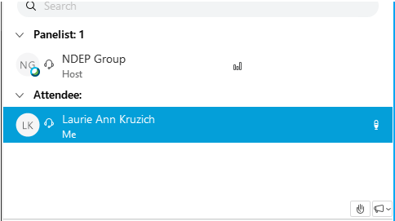
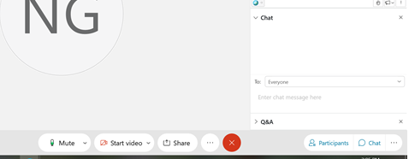
Welcome to the ACEND Virtual Town Hall!
We Will Begin Shortly
Lines have been muted
If you have questions or comments, Use the chat feature and post a chat to EVERYONE

Slide 2
Welcome to the ACEND Virtual Town Hall

Slide 3
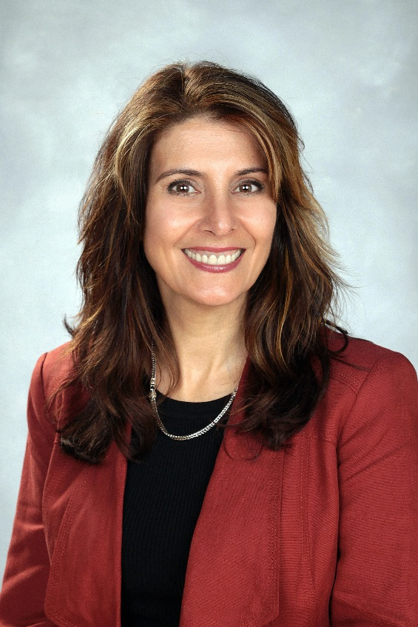
Cheryl Bacon
MS, RD, LDN, FAND
Vice Chair,
ACEND Board
Rayane AbuSabha, PhD, RD ACEND Executive Director

Slide 4
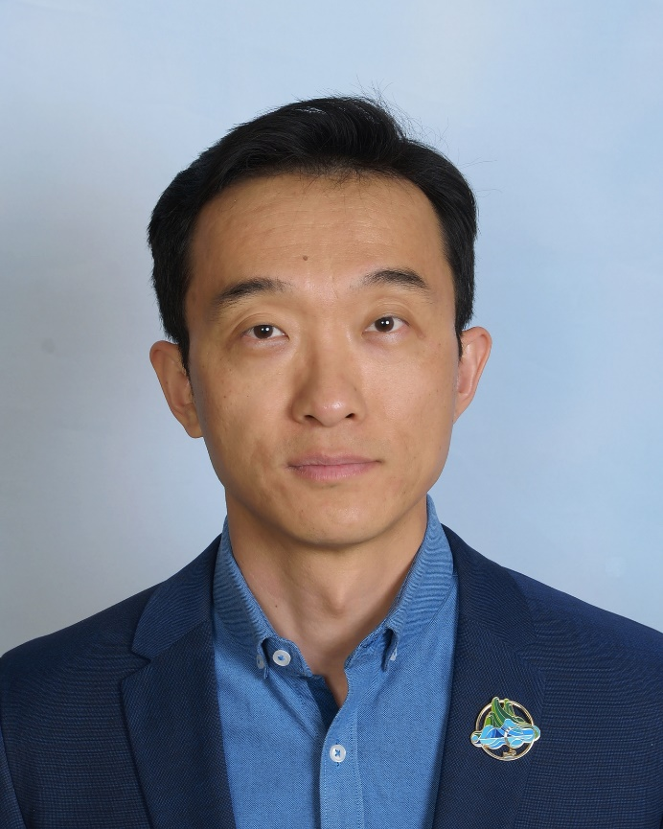
Long Wang,
PhD, MD, RDN, FAND ACEND Board
Notes:
Rayane:
I would like to introduce one of our presenters today. Dr. Long Wang is associate professor at California State University, Long Beach and a member of the ACEND Board
Long you begin here with welcomes…

Slide 5
Objectives
Provide ACEND update and announcements
Provide an overview of ACEND
Discuss options for programs related to the change in credentialing exam eligibility
Answer questions
Notes:
In today’s webinar I will fist start with a few announcements from ACEND then I will
Provide ACEND update and announcements
Provide an overview of ACEND
Discuss options for programs related to the change in credentialing exam eligibility
At the end we will leave time to answer any of your questions

Slide 6
ACEND Updates and Announcements
Notes:
To begin let me give you some updates and announcements from ACEND

Slide 7
Opportunity to Provide Feedback on the Draft 2022 Standards
Revision Process:
Required by USDE at least every 5 years
Input from various sources
Public Comments:
Survey to evaluate the Draft 2022 Accreditation Standards is posted on the ACEND website: https://www.eatrightpro.org/acend/Standards
Constituents
USDE
CDR practice audit
Legal Counsel
CPLS
Licensure
Notes:
Part of our recognition by USDE requires that we review and revise as needed our standards at least every 5 years. We have spent the past year on this process.
We gathered input from different sources. We asked for input from stakeholders about the current 2017 Standards through an online survey in Fall 2019. We reviewed the results of the 2020 CDR practice audit that looked at current entry-level practice and the new USDE regulations. We also had discussions with ACEND’s legal counsel and the legal counsel for the Academy’s consumer protection and licensure subcommittee or CPLS.
The Draft 2022 Standards are posted on the ACEND website along with a recording of the changes within the standards and a list of Frequently Asked Questions with ACED responses. We encourage you to access the survey to provide your feedback and please share it with your program stakeholders and anyone that might be interested in providing feedback on these standards. The survey is posted on the ACEND website at the link shown on this screen and will be open until Wednesday November 18, 2020.

Slide 8
Key Features of the Draft 2022 Standards
Added requirement of a graduate degree for CP and DI prior to 2024 (USDE & legal counsel)
Able to accept students with graduate degrees
Strengthened diversity, equity & inclusion requirements
Strengthened distance education requirements (USDE)
Decreased CP/DI/FDE SP hours from 1200 to 1000 hours
Removed tracks (similar to FEM)
Removed concentration for CP and DI (public comments)
Removed business/public/private entities from DI Standards (USDE & legal counsel)
Grandfathered accredited entities
Notes:
Some key features of the 2022 standards:
Added the requirement of a graduate degree for coordinated programs (CP) and dietetic internship (DI) programs before 2024 (this is to helps us meet USDE regulations and advice from ACEND’s legal counsel)
This is because the missions of the CP and DI programs are to graduate students ready to sit for the RDN exam. We cannot have graduates finish the ACEND program and not be able to sit for the RDN exam. The programs would not then be meeting their mission and, therefore, the promises made to students and interns and we would be out of compliance with USDE regulation by failing to protect our students. Programs will be able to accept students with graduate degrees.
Strengthened diversity, equity & inclusion requirements and weaved these concepts throughout the standards
Following new USDE regulation, we strengthened distance education requirements
Decreased CP/DI/FDE supervised practice hours from 1200 to 1000 hours
Removed ACEND’s data collection of tracks, similar to the future education model accreditation standards
Removed concentration for CP and DI based on many of our constituents’ public comments
Following advice from legal counsel we removed business entities and publicly and privately held corporations from the dietetic internship Standards. This only affects new applications from business entities and does not affect those entities that are already accredited by ACEND who will continue to do so. The rationale for this change is because these entities cannot offer a graduate degree unless they are connected with an educational institution. New business entities and publicly or privately held corporations are encouraged to partner with an educational institution to form a consortium under the 2022 standards or they can apply as a demonstration program under the FEM Standards partnership requirements.

Slide 9
Information for ACEND Programs
Existing CP, DI, DPD, DT, and FDE programs continue under the 2017 and 2022 Standards (In 2022: IDE incorporated into CP)
Under the Proposed 2022 Standards:
DPD/FDE programs remain at the bachelor’s level
DT programs remain at the Associate level
On or before December 31, 2023:
Existing CP programs are required to move to the graduate level
Existing DI programs are required to either only admit students with a graduate degree or combine with a graduate degree
All programs must tell students they need a master’s degree to be eligible to take the CDR registration exam for dietitians after Jan 1, 2024
Notes:
Here is some information for our programs that are currently accredited under the 2017 Standards
All current program types (CP, DI, DPD, DT, FDE) are to continue under the 2017 and 2022 Standards.
Under the Proposed 2022 Standards:
DPD and Foreign Dietitian Education or FDE programs remain at the bachelor’s level
DT programs remain at the Associate level
Existing CP programs are required to move to the graduate level On or before December 31, 2023
Existing DI programs have two choices: They are required to either only admit students with a graduate degree or combine with a graduate degree On or before December 31, 2023
All programs must tell students they need a master’s degree to be eligible to take the CDR registration exam for dietitians after Jan 1, 2024. An information sheet is available on the CDR website on student options after 2024.

Slide 10
New ACEND Board Decisions
Lifted the moratorium on Didactic Programs in Dietetics (August 2020)
Waived the substantive change fee for programs adding a graduate degree (October 2020)
Removed the current Pass rate Policy from the P&P Manual to allow for a more holistic approach to reviewing programs
Notes:
Here are some updates about decisions recently made by the ACEND Board.
During its August 2020 meeting, the ACEND Board lifted the moratorium on Didactic Programs in Dietetics
During its October 2020 meeting, the ACEND Board waived the substantive change fee for programs adding a graduate degree. This is to help assist programs in meeting the CDR graduate requirement. From now until December 31, 2023 the Board will not charge a fee to any program moving to the graduate level.
At its October meeting, the ACEND Board made a decision to no longer use the pass rate policy as a primary factor in making accreditation decisions. This is in line with how many other accreditors. Passing the RDN or NDTR exam is a VERY important outcome for graduates of ACEND accredited programs; however, programs will no longer be reviewed solely based on their graduates’ pass rate level. There are other indicators of program quality that the board will take into consideration to ensure a more holistic review of the quality of our programs.

Slide 11
Demonstration Program Cohort Updates
Future Education Model Updates
In Cohorts 1, 2 & 3
30 Future Graduate
3 Future Bachelor’s
25 programs in process
Cohort 4
Applications were reviewed and 28 are in process
Cohort 5
Applications due December 2, 2020
Posted on the ACEND website: https://www.eatrightpro.org/futuremodel
Notes:
Here is an update on where we are in the process for the Future education model standards. As you have heard, the FEM programs are being accepted as demonstration programs in cohorts.
In Cohorts 1, 2 and 3, ACEND Accredited 30 Future Graduate Programs and 3 Future Bachelor’s.
Overall, 25 programs remain in process.
For Cohort 4, the applications were reviewed this spring and we have 28 programs in process.
We have issued the call for applications for cohort 5. Those applications are due December 2, 2020. The application can be found on the ACEND website at the link shown on this screen

Slide 12
Rationale for Future Education Model Standards
FEM Rationale document and results of data collected from demonstration programs found on ACEND’s Website
Eatrightpro.org/acend/futuremodel
Notes:
I would like to remind our programs that all information about the Future Education Model data that was collected for the development of the FEM standards, the rationale document and any new data and results are being shared on the ACEND FEM webpage.

Slide 13
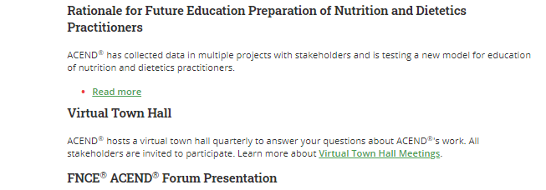
Rationale for Future Education Model Standards
Eatrightpro.org/acend/futuremodel
Rationale Document on FEM Webpage
Town Hall recording on the results of 2018-2019 program director surveys
Notes:
ACEND developed the rationale document on the Future Education Model which is posted on the ACEND future model webpage you see on the screen. The rationale document details all the data collected in multiple projects with stakeholders about this new model for education of nutrition and dietetics practitioners. We continue to add and update this document and on this webpage we share the results of each step of the process. We are beginning to post the results of surveys collected from the demonstration programs. Recently, we added a link to the recorded presentation that I provided during the April 2020 Town Hall on the results of the program director surveys that were collected in 2018 and 2019. (Long you may expand if you want about doing more analyses and presentations; for example about the poster you had at FNCE which we may post here too and upcoming analyses).

Slide 14
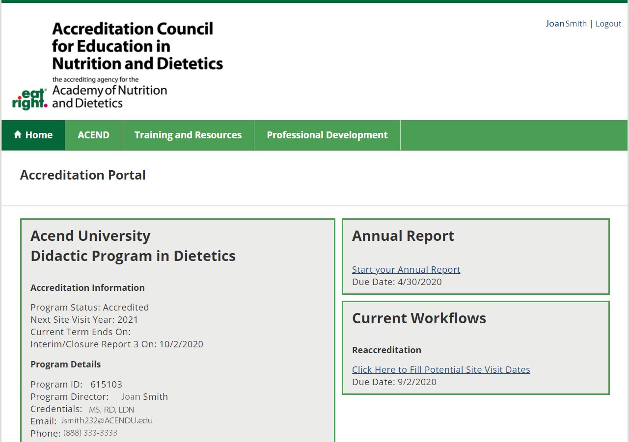
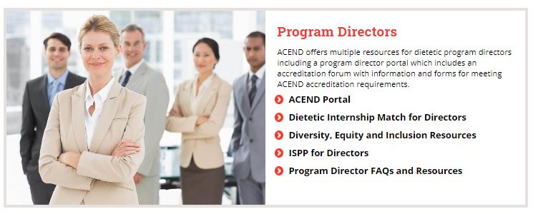
NEW!
ACEND Accreditation System
Program director portal
Program Reviewer portal
Easy to use
Notes:
ACEND is happy to announce a new accreditation system with a program director and program reviewer portal. Onn October 27, all program directors received an email about this portal with directions on how to use it and complete their annual report. The annual report is due December 18, 2020.
On October 29, program reviewers received instructions about accessing the portal to complete their program reviewer profiles and upload a new CV. We ask that each reviewer complete their profile and upload their CV by November 9, 2020.
This system was developed to improve the ACEND stakeholder experience with accreditation tasks as well as increase efficiency of ACEND’s processes. It should be easy to use and is based on Microsoft dynamics. The portal can be accessed from the ACEND website under the program directors’ section.”

Slide 15
Diversity, Equity and Inclusion
New ACEND Webpage on the ACEND Website
www.eatrightPRO.org/ACENDforDEI
Submit DEI noteworthy practices – on recruitment, retention, in-class/rotation activities
Reviewed by ACEND’s DEI task force
Notes:
ACEND has a new webpage dedicated to diversity, equity and inclusion. On this webpage, ACEND is gathering DEI noteworthy practices. If your program is engaged in a noteworthy practice to increase the diversity of students enrolled in your program, or to provide students with experiences in this area, or any other valuable practices, we encourage you to submit your work. These noteworthy practices will be reviewed by ACEND’s diversity, equity and inclusion task force

Slide 16
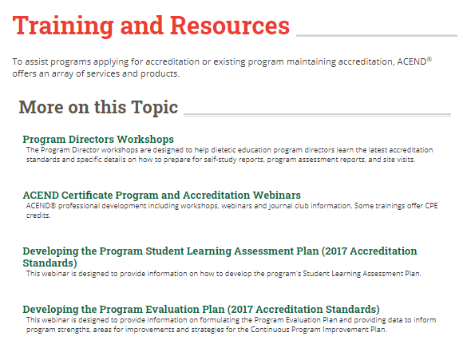
ACEND Certificate Program and Accreditation Webinars
ACEND Online Modules for Program Directors
ACEND Leadership and Professional Communication Skills Certificate
Training to build leadership skills and improve communication and management skills
8 modules from Academy’s Leadership Training Courses
Discounted for ACEND stakeholders
16 CPEUs
Notes:
New from ACEND is a Leadership certificate training. This certificate program will provide ACEND® stakeholders with training to build leadership skills and improve communication and management skills. It includes eight modules that were chosen from the Academy's Leadership Training Courses. These modules are discounted for ACEND stakeholders.
To access these modules go to the ACEND training and resources section and select “ACEND Certificate Program and Accreditation Webinars”

Slide 17
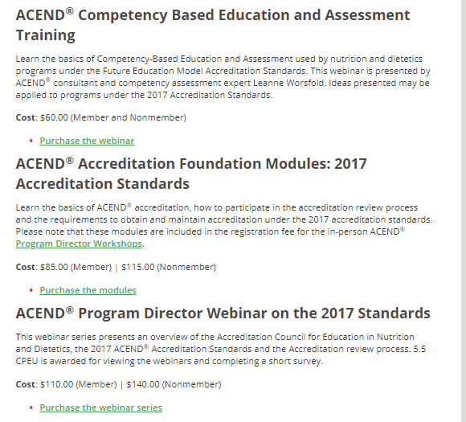
ACEND Certificate Program and Accreditation Webinars
ACEND Online Modules for Program Directors
Program Director Webinar on the 2017 Standards
Covers 2017 Standards and ACEND review process
5.5 CPEUs
Competency Based Education and Assessment Training
Presented by Leanne Worsfold
5 CPEUs
Notes:
Also under the ACEND Certificate Program and Accreditation Webinars page, you will find several modules specifically for program directors.
The program director webinar on the 2017 Standards is designed to help dietetic education program directors learn the latest accreditation standards and specific details on how to prepare for self-study reports, program assessment reports, and site visits. These modules include the content of the in-person program director workshops.
New this year is the competency based education and assessment training that was added based on requests from our program directors. This virtual training was recorded live and presented by ACEND® consultant and competency assessment expert Leanne Worsfold. It covers the basics of Competency-Based Education and Assessment used by nutrition and dietetics programs under the Future Education Model Accreditation Standards. Ideas presented may be applied to programs under the 2017 Accreditation Standards. This way the CBE information and training is available virtually to all our programs.

Slide 18
Communication from ACEND
ACEND Update
Periodic update from ACEND posted on the website
Virtual Town Hall
Next town hall: Tuesday January 19, 2021, 11:00 am – 12:00 noon Central Time.
Directions for joining on the ACEND website
ACEND Staff
800-877-1600 x5400
acend@eatright.org
Notes:
ACEND will continue to issue periodic updates on its work on standards development and will include answers to questions it has received. Back issues of these updates are posted on the ACEND website
ACEND also will continue its virtual town hall on a periodic basis. These town halls provide an opportunity for stakeholders to ask questions and ACEND to gain input on its standards work. The next town hall is set for Tuesday January 19 from 11:00 am – 12:00 noon central time
The ACEND staff are always available to assist you and answer any questions you may have. ACEND’s phone number and email is shown on the screen.

Slide 19
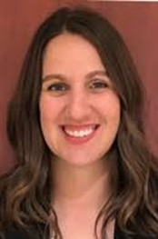
Cheryl Bacon
MS, RD, LDN, FAND
Vice Chair,
ACEND Board
Notes:
Now, it is my pleasure to introduce Cheryl Bacon, Vice Chair of the ACEND Board. Cheryl is the program director of a free-standing Dietetic Internship at UChicago Medicine Ingalls Memorial, in Harvey, Illinois. And today Cheryl we will be discussing Free Standing Dietetic Internship options to meet CDR’s increased eligibility requirements for 2024

Slide 20
ACEND Overview
Notes:
Cheryl: Welcome notes….
Here is an overview of ACEND with some updates and announcements

Slide 21
Academy Relationships
Academy of Nutrition and Dietetics
ACEND
HOD
CDR
BOD
CDR
ACEND
Accrediting Agency for Nutrition and Dietetics Education Programs
Credentialing Agency for Nutrition and Dietetics Practitioners
CFP
Notes:
First I want to explain ACEND’s relationship to the Academy of Nutrition and Dietetics. The Academy is a legally incorporated, not-for-profit corporation. It is a professional membership organization that provides products and services to its members and strives to empower members to be food and nutrition leaders. The Board of Directors oversees the strategic direction, budget, guidelines and policies of the Academy of Nutrition and Dietetics.
ACEND, although a part of the Academy not-for-profit corporation, is required by the US Department of Education to function autonomously from both the Academy and the Commission on Dietetic Registration – CDR. All decisions made about accreditation standards and accreditation status are made by the ACEND Board without interaction or influence by either the Academy or CDR.
CDR, too is part of the Academy not-for-profit corporation. CDR also functions autonomously from the Academy and ACEND in making credentialing decisions.
This is a graphic representation of some of the key components of the Academy of Nutrition and Dietetics organizational structure that I want to address today

Slide 22
ACEND
Mission: Ensure the quality of nutrition and dietetics education
ACEND
Administrative autonomy
Sets national standards for education accreditation
Evaluates education programs against standards
Notes:
The Accreditation Council for Education in Nutrition and Dietetics – or ACEND is legally part of the Academy but is required by the US Department of Education to function administratively autonomously from the Academy. ACEND’s mission is to ensure the quality of nutrition and dietetics education and it serves as the accrediting agency for the Academy. It sets national standards for education accreditation in nutrition and dietetics and evaluates education programs against those standards.

Slide 23
CDR
Academy of Nutrition and Dietetics
Administrative autonomy
Sets national criteria for registration and credentialing
Develops/administers credentialing examinations
Monitors ongoing continuing education
CDR
BOD
ACEND
Mission: Administer rigorous, valid and reliable credentialing processes
Notes:
The Commission on Dietetic Registration – or CDR is legally part of the Academy but is required by its accrediting agency, the National Commission for Certifying Agencies to function administratively autonomously from the Academy. CDR’s mission is to administer rigorous, valid and reliable credentialing processes to protect the public and meet the needs of nutrition and dietetics practitioners, employers and consumers. It serves as the credentialing agency for the Academy. It sets national criteria for registration and credentialing eligibility and maintenance, develops and administers credentialing examinations and monitors ongoing continuing education of those holding credentials.

Slide 24
Organizational Structure
CDR
ACEND
BOD
January 1, 2024 requirement
Graduate degree for RDN exam
2022 Standards, include graduate degree
Before December 31, 2023
Notes:
While CDR and ACEND are autonomous, which means the boards function and make decisions independently from each other, ACEND decisions cannot be made in a vacuum. In fact as you heard from Long, new USDE regulations require ACEND to adjust our standards to be in line with changes in credentialing and licensure requirements. With the upcoming CDR credentialing requirement in 2024 for students to have a graduate degree to sit for the RDN exam, the ACEND standards had to change in response. ACEND’s accreditation legal counsel made it clear that ACEND cannot have programs with a mission to prepare RDNs and have the graduates finish the ACEND program and NOT be able to take the exam right away because of the “hurdle” of another degree. As Long mentioned, the missions of the CP and DI programs are to produce graduates ready to sit for the RDN exam. Having graduates finish and then wait 2-3 years to complete a master’s before they can go out into the workforce is not fair to the student, but also shows USDE that our programs are not meeting their mission and their promises to their students.
In light of this the ACEND Board made the difficult decision for the 2022 Standards to set the deadline date for CP and DI programs to move to the graduate level by December 31, 2023. DI programs have the option to only accept students who have completed their graduate degree.

Slide 25
Proposed Draft 2022 Standards
By December 31, 2023, Dietetic Internships must:
Combine with a graduate degree, or
Only accept students with graduate degrees
Proposed 2022 DI Standards, RE 1.4
Notes:
I want to assure you that it is never the intention of ACEND to eliminate our free-standing DIs. They are key to the success of students and valuable to ACEND and the education community. A DI will have the choice to accept students with a graduate degree or to collaborate with a university or college to offer a graduate degree. This will be a major program change to be submitted to ACEND. ACEND is not requiring changes to the DI curriculum or rotations as long as the graduate degree is offered along with the DI. Students for example can start the master’s courses one year before their rotations start and finish the second year with the DI rotations and remaining MS courses which could be thesis or capstone project, they can combine the capstone project with the DI experience, or they can take courses that compliment the rotations, for example Advanced MNT or a public health course. And this is just one example out of many ways this can be done.
Programs have to come into compliance with this requirement by December 31, 2023. From ACEND’s perspective you do not have to have the graduate degree added to the DI, or to accept students with a graduate degree until December 31, 2023. But I urge programs to start thinking about this now for the benefit of your students and interns. To assist our programs in making this change, as Long mentioned the ACEND Board made the decision to waive the program change fee for ACEND programs that decide to move to the graduate level.
What you see posted on the slide are the recommended changes to the DI Standards.

Slide 26
ACEND has no plans to leave any program behind
Notes:
ACEND has no plans to leave any program behind. The ACEND staff are available to work with you and answer your questions through this transition.

Slide 27
Accredited Free-Standing Dietetic Internships
Total Number
Total Dietetic Internship Programs | 262
DIs housed in a college or university | 182
Free-standing DIs: DIs not housed in a college or university | 80
Notes:
ACEND currently accredits close to 600 programs in the US and internationally of which 262 are dietetic internship programs. Of these DIs, about 80 are free-standing dietetic internships that are not housed in a college or university

Slide 28
Dietetic Internship Match Data
2019/2020 Match
 | April 2019
 | (n) | (%)
Total Participants | 4,201 | 100%
Students Matched | 2,565 | 61%
Students Preselected | 199 | 5%
Students Not Matched | 1,437 | 34%
April 2020
(n) | (%)
3,848 | 100%
2,485 | 65%
228 | 6%
1,135 | 29%
Many DPD graduates remain without a dietetic internship
Notes:
Some dietetic internship program directors are expressing concerns that with the two sets of standards, they may see a decline in the number of students applying to dietetic internships.
As you see in this table, even with the improved number of filled positions in April 2019, and 2020, there are still large numbers of students that did not get a match. There is still a great need for dietetic internships and there are many applicants who need internship positions. This is not counting all the DPD students from previous years who did not get matched and may be working in the community or went on for graduate school and are still looking for internships. Now is a good time to reach out to the qualified past DPD graduates and encourage them to reapply to internships because their chances to find a match are increasing.

Slide 29
Options Specific to Free Standing Dietetic Internships
Notes:
In light of the coming changes, let me review the new options for our DIs and especially the free-standing dietetic internship program. But these options apply to all dietetic internship programs

Slide 30
Possible Options for Dietetic Internships
Only admit interns with graduate degree
Submit change to combine with a graduate degree
Form a consortium with another institution to offer the graduate degree (2017/2022 Standards)
Partner to offer an FG program (FEM Standards)
Notes:
Dietetic internship programs have 4 possible options to consider:
Option 1 Only admit interns who completed their graduate degree
Option 2 Submit a program change to become an accredited graduate degree/DI program, for example an MPH/DI or MA/DI
Option 3 Form a consortium with an academic institution to offer the graduate degree. This is very much like the partnership model in the FEM Standards
Option 4 partner with an academic institution to offer a Future Graduate program under the Future Education Model
The last two options, Options 3 and 4 are similar in structure, and the difference is which standards the DI decides to follow.
Next, we will review each option and share potential opportunities and challenges for each of these options.

Slide 31
Option 1: Only Admit Interns who Completed their Graduate Degree
Only admit interns with a graduate degree
Combine with a graduate degree
Form a consortium with an institution to offer graduate degree
Partner to offer an FG program
Notes:
Option 1 is to only admit students who completed their graduate degree.

Slide 32
Option 1: Only Admit Interns who Completed their Graduate Degree
Dietetic internship stays the same but requires a graduate degree for admission into the program
Only admit interns with a graduate degree
Combine with a graduate degree
Form a consortium to offer a graduate degree
Partner to offer an FG program
Notes:
In this option, the Dietetic internship stays the same but changes its admission policies by requiring a graduate degree for admission into the program

Slide 33
Graduate Degree
CC: https://unsplash.com/photos/7iSEHWsxPLw
Notes:
DPD or FDE graduates can apply to the internship after they have completed their graduate degree

Slide 34
Option 1: Only Admit Interns who Completed their Graduate Degree
Possible Routes
DPD/FDE
DPD/FDE resulting in a graduate degree
or
Graduate degree
Dietetic Internship
Verification Statement
RDN Exam
Notes:
Here is a graph that shows what it would look like if a DI only admits students with graduate degrees. Students admitted can either complete the DPD then separately pursue the graduate degree or they can complete a graduate level DPD program, before applying to the DI . Once the student completes their supervised practice, they receive the verification statement and are able to sit for the RDN exam.
FDE = Foreign Dietitian Education program

Slide 35
Option 1: Only Admit Interns who Completed their Graduate Degree
Opportunities:
Less work for the program
Graduates can take RDN exam immediately
Possible Challenges:
Smaller pool of applicants
Only admit interns with a graduate degree
Combine with a graduate degree
Form a consortium to offer a graduate degree
Partner to offer an FG program
Notes:
Some of the opportunities option 2 provides are:
Less work for the program
Graduates can take the RDN exam immediately with no wait time to complete the graduate degree where loss of knowledge may occur
Some possible challenges could be that the DI will start drawing from a smaller pool of applicants since not all DPD graduates will have a graduate degree. And this pool may shrink over time

Slide 36
Option 2: Submit Change to Combine with a Graduate Degree (Become a graduate degree/DI)
Only admit students with a graduate degree
Combine with a graduate degree (Grad degree/DI)
Form a consortium
Partner to offer an FG program
Notes:
Option 2 is to request a major program change to add a graduate degree to the DI . For example, change the program to an MS/DI, MPH/DI, MBA/DI or other combination

Slide 37
Option 2: Submit Change to Combine with a Graduate Degree (Become a graduate degree/DI)
Dietetic internship combines with a graduate degree (MS, MA, MPH, MBA, PhD, DCN, etc.)
Verification statement provided only after interns complete the graduate degree
Only admit interns with a graduate degree
Combine with a graduate degree
Form a consortium to offer a graduate degree
Partner to offer an FG program
Notes:
The dietetic internship has the option to combine with any type of graduate degree (MS, MA, MPH, MBA, PhD, DCN, etc.). The verification statement is provided only after the students complete the graduate degree
In this situation, a university can be working with several DI programs. So the free-standing DI will be incorporating the degree into the DI program. The new graduate degree-DI most likely will be housed with the free-standing DI.

Slide 38
Option 2: Submit Change to Combine with a Graduate Degree (Become a graduate degree/DI)
Possible Routes
DPD/FDE
DPD/FDE with graduate degree
Graduate Degree
Dietetic Internship
Verification Statement
RD Exam
Notes:
As you see in this graph, in this route the DI combines with the graduate degree program for the interns to complete the supervised practice simultaneously with the graduate degree. The program can adopt a number of different models for completing the graduate coursework: this can be before the supervised practice, after or at the same time as the supervised practice. The verification statement is issued only after both the supervised practice and the graduate degree are completed, at which time the graduate can sit for the RDN exam.
These programs, with a prior learning assessment policy can always accept students with a graduate degree

Slide 39
Option 2: Submit Change to Combine with a Graduate Degree (Become a graduate degree/DI)
Opportunities:
Larger pool of program applicants
Simpler application, if program chooses to transition to FEM Accreditation Standards
Only admit interns with a graduate degree
Combine with a graduate degree
Form a consortium to offer a graduate degree
Partner to offer an FG program
Notes:
Possible opportunities for this option include:
There is the possibility of having a larger pool of program applicants
Simpler application, if program chooses to transition to the Future Education Model Accreditation Standards at a later point in time. The program would be categorized as a reorganization with a follow-up report and not a candidacy that would include the entire self-study report and a site visit

Slide 40
Option 2: Submit Change to Combine with a Graduate Degree (Become a graduate degree/DI)
Possible Challenges:
Initial increase in workload to plan program & submit major program change to ACEND (Fee waived)
Articulation agreement, MOU may need to be established
Possibility of having to share decision making with regards to portions of the DI curriculum
Only admit interns with a graduate degree
Combine with a graduate degree
Form a consortium to offer a graduate degree
Partner to offer an FG program
Notes:
Possible Challenges include:
An initial increase in workload to plan the program & submit the major program change to ACEND because you will become an accredited DI at the graduate level. To do so, the program will not have to pay the program change fee. During its October meeting, the ACEND Board voted to waive the accreditation fee for all programs applying to move to the graduate levels
You may need to develop an articulation agreement or an MOU with the educational institution
Because the programs are more intertwined, depending how the program is structured there will be the possibility of having to share decision making power over the DI curriculum, or at least make some concessions and/or adjustments to work with the graduate program.

Slide 41
Option 3: Form a Consortium with an Educational Institution to Offer a Graduate Degree Program
Only admit students with a graduate degree
Combine with a graduate degree (Grad degree/DI)
Under the 2017/2022 Standards
Form a consortium
Partner to offer an FG program
Notes:
Option 3 is to form a consortium with an educational institution to offer the graduate degree with the supervised practice as one single graduate education program.

Slide 42
Option 3: Form a Consortium with an Educational Institution to Offer a Graduate Degree Program
DI enters into a consortium agreement with a university/college to offer a single program under the 2017 (or 2022) Accreditation Standards
Provides recognition to both institutions
Verification statement provided after students complete the program
Only admit interns with a graduate degree
Combine with a graduate degree
Form a consortium
Partner to offer an FG program
Notes:
In this model the dietetic internship enters into a consortium agreement with a university/college to offer a single Graduate degree/DI program accredited under the 2017 (or 2022) Accreditation Standards. The consortium arrangement gives recognition to both institutions.
The Verification statement is provided after students complete the program

Slide 43
Option 3: Form a Consortium with an Educational Institution to Offer a Graduate Degree Program
Institution One
DI Program
Institution Two
Graduate Program
Formal agreement
DPD/FDE with graduate degree
Graduate DI
(one program)
Verification Statement
RDN Exam
Notes:
In this graphic, you see that this is an agreement between two institutions to work together through a formal agreement and offer one single education program: a graduate program with supervised practice or a graduate DI.
These programs, with a prior learning assessment policy can always accept students with a graduate degree

Slide 44
Option 3: Form a Consortium with an Educational Institution to Offer a Graduate Degree Program
Opportunities:
Larger pool of program applicants (DPD/FDE students)
Simpler application, if program chooses to transition to FEM Accreditation Standards
Provides recognition to both institutions
Both programs listed on ACEND website
Only admit interns with a graduate degree
Combine with a graduate degree
Form a consortium
Partner to offer an FG program
Notes:
Possible opportunities for this option include:
There is the possibility of having a larger pool of program applicants (Undergraduate DPD and FDE students)
Simpler application, if program chooses to transition to FEM Accreditation Standards at a later point in time. The program would be categorized as a reorganization with a follow-up report and not a candidacy that would include the entire self-study report and a site visit
The consortium arrangement gives recognition to both institutions where both programs will be listed on the ACEND website. This allows an applicant to find the program either under the DI name or university name on the ACEND website.

Slide 45
Option 3: Form a Consortium with an Educational Institution to Offer a Graduate Degree Program
Possible Challenges:
Initial significant increase in workload to plan program
Formal agreement must be established
Coordinator must be assigned at each institution (one may be the program director)
Program decisions shared
Both institutions pay ACEND fees
Only admit interns with a graduate degree
Combine with a graduate degree
Form a consortium
Partner to offer an FG program
Notes:
Possible Challenges include:
Initial significant increase in workload to plan the program
A formal agreement must be established between the two organizations that jointly sponsor the program. The formal agreement between the members of the consortium have to clearly define financial and other resource contributions of each institution to the total program
A coordinator must be assigned at each institution; one of these coordinators may be the ACEND program director. The two organizations have to decide where the program director will reside.
In a consortium program decisions are shared, program name may be a combination of both programs, and both institutions will have to pay the ACEND annual fee and will have increased site visit fees.

Slide 46
Option 4: Partner to Offer a Future Graduate Program under the Future Education Model Standards
Only admit students with a graduate degree
Under the FEM Standards
Combine with a graduate degree (Grad degree/DI)
Form a consortium
Partner to offer an FG program
Notes:
Option 4 and the last option is to enter into a partnership with an educational institution to offer a Future Graduate program under the future education model accreditation standards. This is very similar to the consortium arrangement in the 2017 standards

Slide 47
Option 4: Partner to Offer an FG Program
DI partners with a university/college to offer an FG program under the Future Education Model (FEM) Accreditation Standards
Verification statement provided after students complete the FG program
Only admit interns with a graduate degree
Combine with a graduate degree
Form a consortium
Partner to offer an FG program
Notes:
In this model the DI partners with a university/college to offer a future graduate program under the FEM Standards and the Verification statement is provided after students complete the FG program

Slide 48
Option 4: Partner to Offer an FG Program
Possible Routes
ACEND accredited program: e.g., FB, FDE, DPD, BS/CP
Other undergraduate degree
Bachelor’s + Graduate (e.g., 3+2, 4+1)
FG
Prerequisites
FG
Verification Statement
Verification Statement
RDN Exam
RDN Exam
Notes:
On this slide you see multiple ways to set up a future graduate program. In the first chart on the left-hand side, you see that an FG has the option to accept students from many different programs including the DPD, the Future Bachelor’s (FB) and/or bachelor’s coordinated program. An FG can also accept students with other undergraduate degrees that are not ACEND-accredited; these students most likely will have to complete a number of prerequisites before they enroll in the FG.
Another model that you see on the right-hand side shows an FG program that starts at the undergraduate level where students complete their undergraduate, graduate and experiential learning all in one single program. This can be a 5 year 3+2 program, 4+1 or any other combination or number of years.
The FG program typically sets their prerequisites and establishes prior learning assessment policies. At the end of the program the student will receive the verification statement and is able to sit for the RDN exam

Slide 49
Option 4: Partner to Offer an FG Program
Opportunities:
Graduate eligible to take the RDN exam upon graduation
Wider net to recruit students: DPD, FB, post-baccalaureate, etc.
Provides recognition to both institutions
All FEM demonstration program benefits
Only admit interns with a graduate degree
Combine with a graduate degree
Form a consortium
Partner to offer an FG program
Notes:
The possible Opportunities of this option include
The graduate is eligible to take the RDN exam upon graduation
As you saw in the graphics, the program will have a wider net to recruit students: DPD, FB, and any post-baccalaureate program
You receive all the benefits of FEM demonstration programs including all expenses to attend the competency-based education trainings, the support from ACEND and other demonstration programs and financial benefits such as a one-year annual fee waived.

Slide 50
Option 4: Partner to Offer an FG Program
Possible Challenges:
Initial increase in workload to plan program & submit application
Formal agreement with the college/university must be established
Coordinator at each institution
Increased demand for communication between partners
Curriculum decisions are shared by the partners
Both institutions pay ACEND fees
No change
Only admit interns with graduate degree
Offer the option of a graduate degree at another institution
Submit change to graduate degree/DI
Partner to offer an FG program
Notes:
Possible Challenges include
A partnership under the FEM Standards is very similar in structure to a consortium under the 2017 standards.
The initial increase in workload to plan the program & submit the application
A formal agreement has to be established with the college/university
A coordinator must be assigned at each institution; one of these coordinators may be the ACEND program director. The two organizations have to decide where the program director will reside.
There will be an increased demand for communication between the two partners (the experiential learning site which is the current DI and the faculty in the graduate program)
And the integration of the supervised experiential learning with the didactic curriculum will require that the curriculum decisions be shared by the partners
In a partnership, the same way with a consortium, both institutions will have to pay the ACEND annual fee and will have increased site visit fees.

Slide 51
Option 4: Partner to Offer an FG Program
Partnership Considerations
Partnership Agreement
Program may be housed at the college/university or at the institution where the free-standing DI is housed
Financial agreement must be delineated part of the MOU between the college and the facility
Guidelines for Partnership: www.eatrightpro.org/futuremodel
Notes:
In a partnership agreement, the program may be housed at the college/university or at the institution where the free-standing DI is housed
The formal partnership agreement must detail how tuition will be paid. Details on the guidelines for partnership can be accessed on the ACEND website under the future model webpage.

Slide 52
FEM Demonstration Project Reorganization Application Process
Multi-phase process
Initial application
Compliance with Standards 1, 2, 6
Standard 1. Program Characteristics and Resources
Standard 2. Program Mission, Goals and Objectives
Standard 6. Faculty and Preceptors
Training
Final application
Reorganization report or self-study report and site visit – includes curriculum
Notes:
If you are interested in applying to become a graduate program under the FEM Standards, I want to remind you that the application process to become a demonstration program is a multi-phase process.
The initial application involves programs showing their compliance with just a few of the standards 1, 2, and 6. At this early stage there is no expectation to have the curriculum all ironed out. Instead once applications are accepted, program faculty attend trainings on competency-based education and assessment. They also receive support from ACEND and from other demonstration programs to build their curriculum and assessment.
It is only after the CBE trainings that programs take the time to develop and iron out their curriculum and submit their report for approval by the Board.

Slide 53
Cohort 5 Application Process
Application
Application, Guidance Document and information webinar available at: www.eatrightpro.org/FutureModel
Cohort 5 Demonstration Program Application due: December 2, 2020 by 11:00 am Central Time
Board decision March/April 2021
Latest program start date Fall 2026
Notes:
ACEND issued a call for applications for programs interested in being demonstration programs earlier this year. The applications for the fifth cohort are due December 2nd.
The demonstration program application form and guidance documents are available on the ACEND Future Education Model Webpage shown on this slide.
ACEND is seeking representative sample of programs in terms of geographic location, program size, and proposed program structure
Cohort 5 Applications are reviewed by the Board during the March or April Board conference call, the Board will vote to accept the application as a reorganization or a candidacy. Cohort 5 programs must enroll students and start their first class on or before Fall 2026.
During its upcoming Board meeting the Board will be discussing if ACEND will hold a 6th round of demonstration program applications.

Slide 54
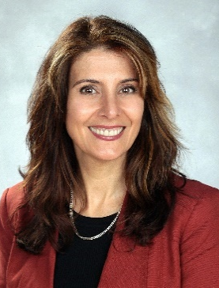
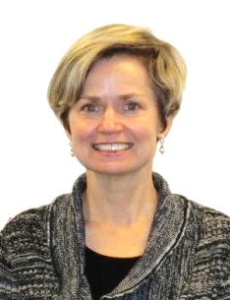
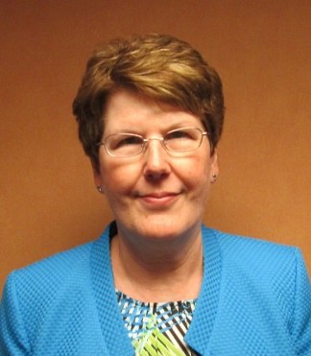
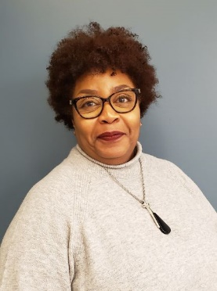
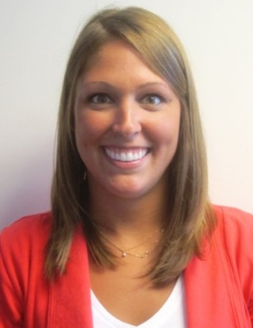
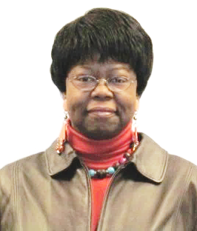
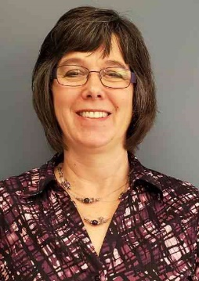
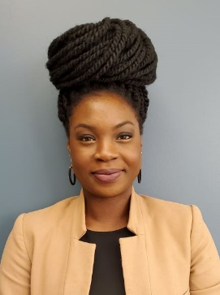
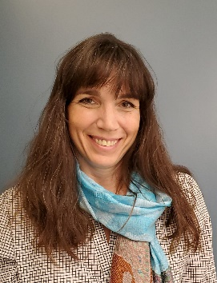
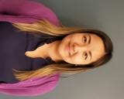
ACEND staff are always available to assist you
Rayane AbuSabha Mary Ann Taccona Amy Anichini Lauren Bozich Elise Cowie Debbie Donegan
Jackie Johnson Laurie Kruzich Jamie Pak Stephanie Parry Jodi Wright
Contact your ACEND manager or ACEND
800-877-1600 x5400
acend@eatright.org
Notes:
I want to end today’s presentation by reminding our programs that the ACEND staff are always available to assist you and answer your questions. ACEND’s phone number and email are shown on the screen.

Slide 55
Questions or Comments? Use the Chat feature; send message to “everyone”
Notes:
Now I will open it up for your questions or comments.

